Slide 1

2025 KFF Employer Health Benefit Survey
October 22nd, 2025

Slide 2
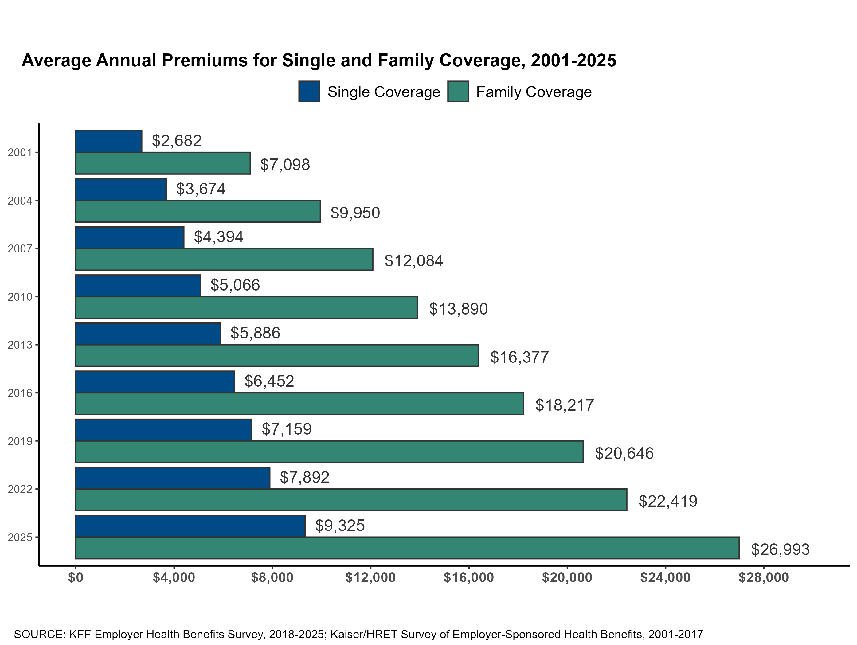

Figure 1
1

Slide 3
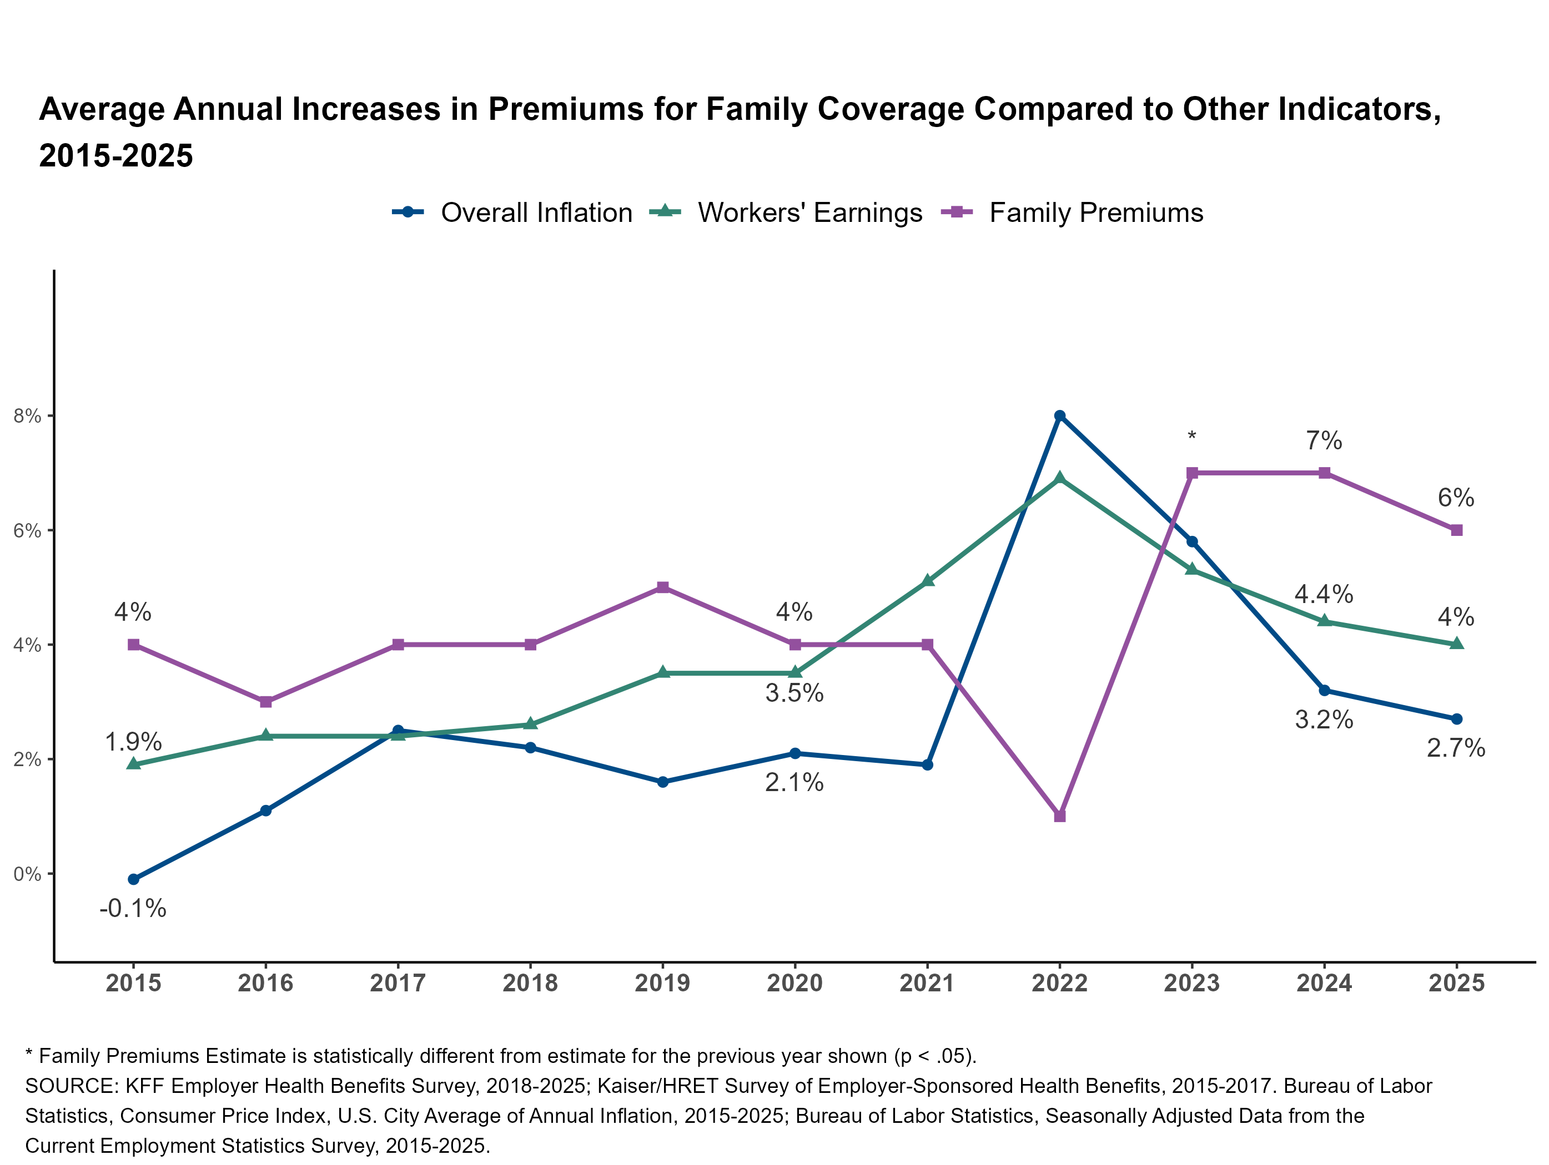
Figure 2
2

Slide 4
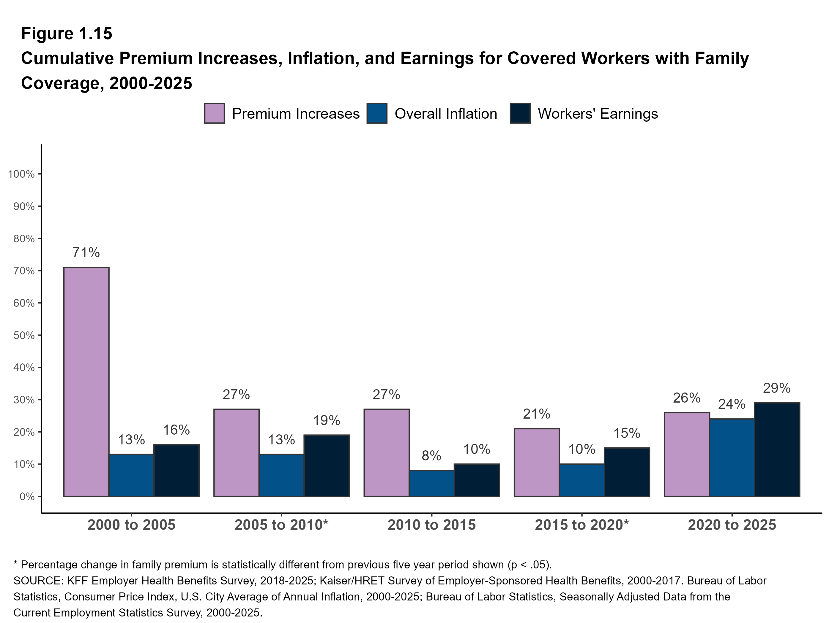
Figure 3
3

Slide 5
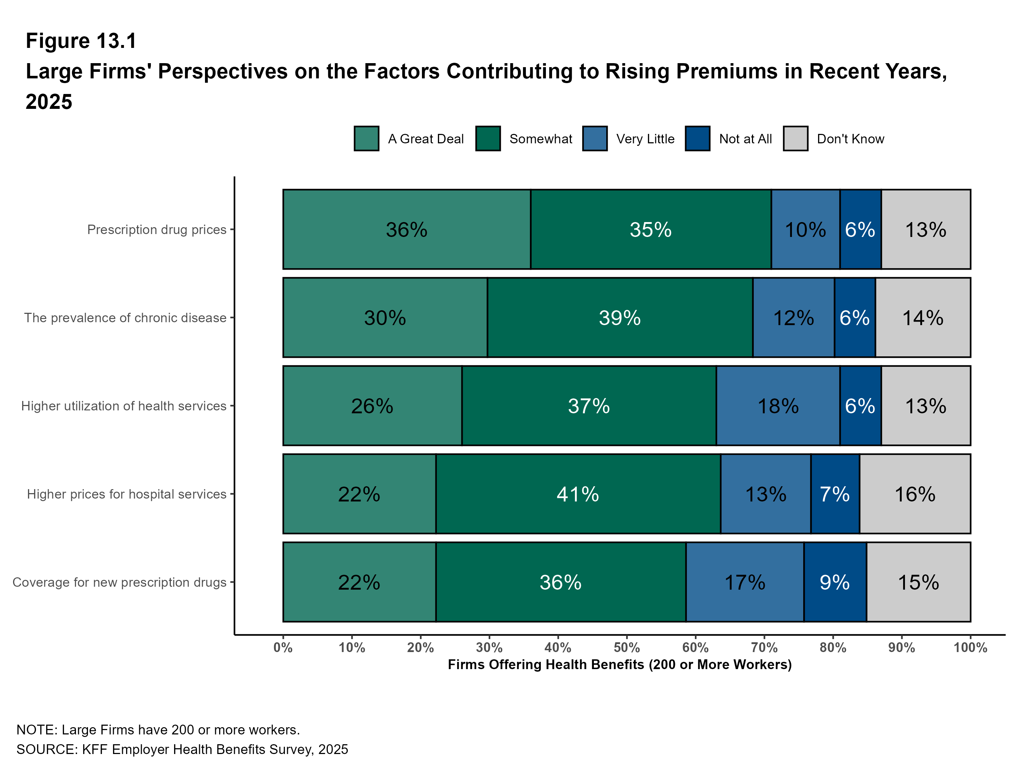
Figure 4

Slide 6
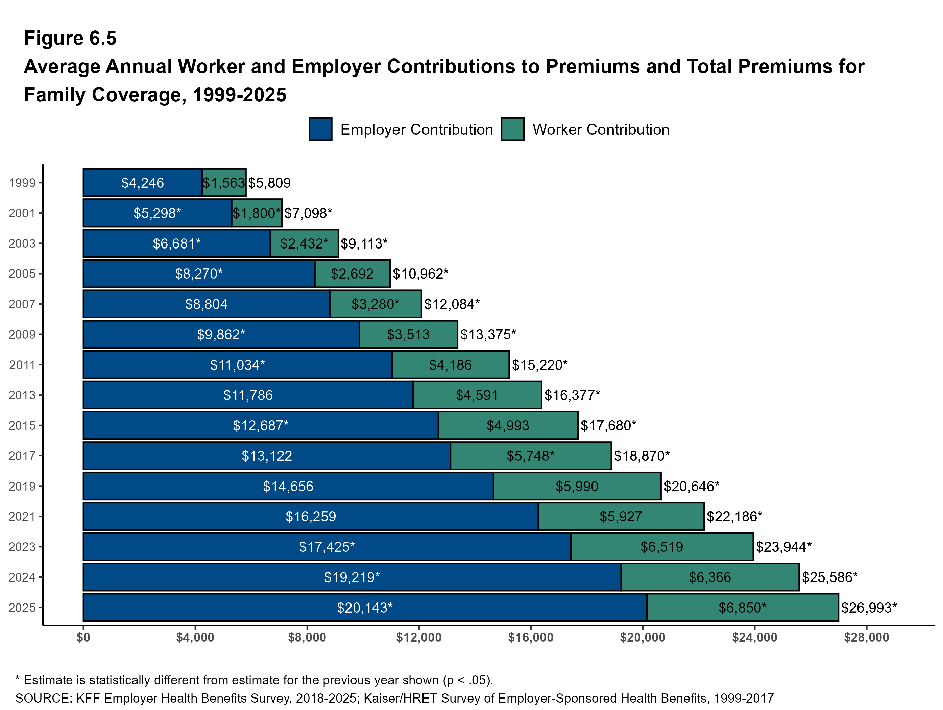
Figure 5
5

Slide 7
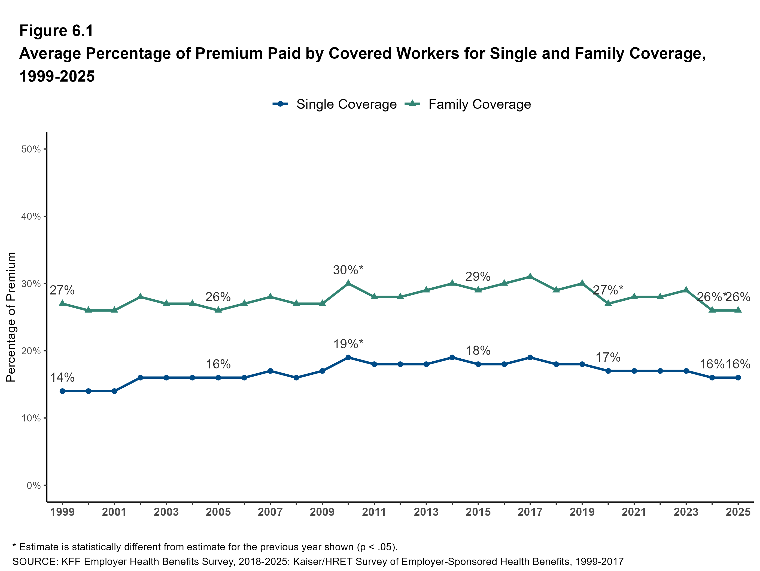
Figure 6
6

Slide 8
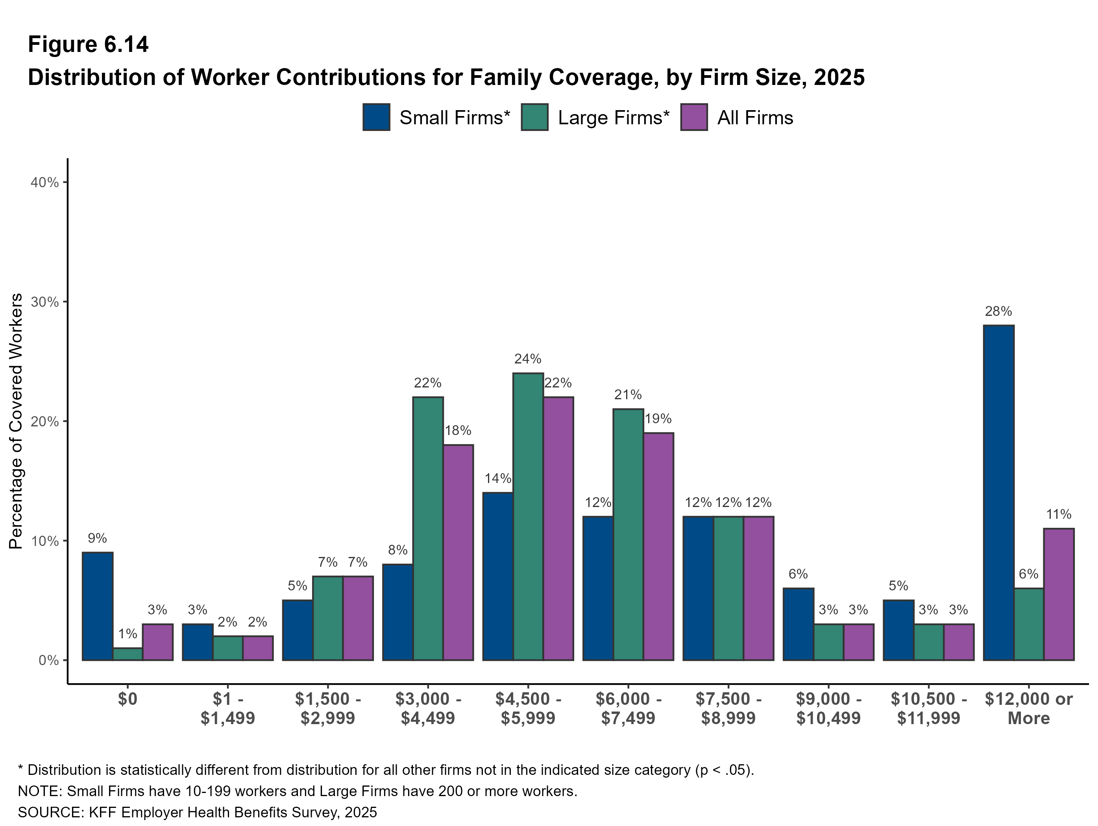
Figure 7
7

Slide 9
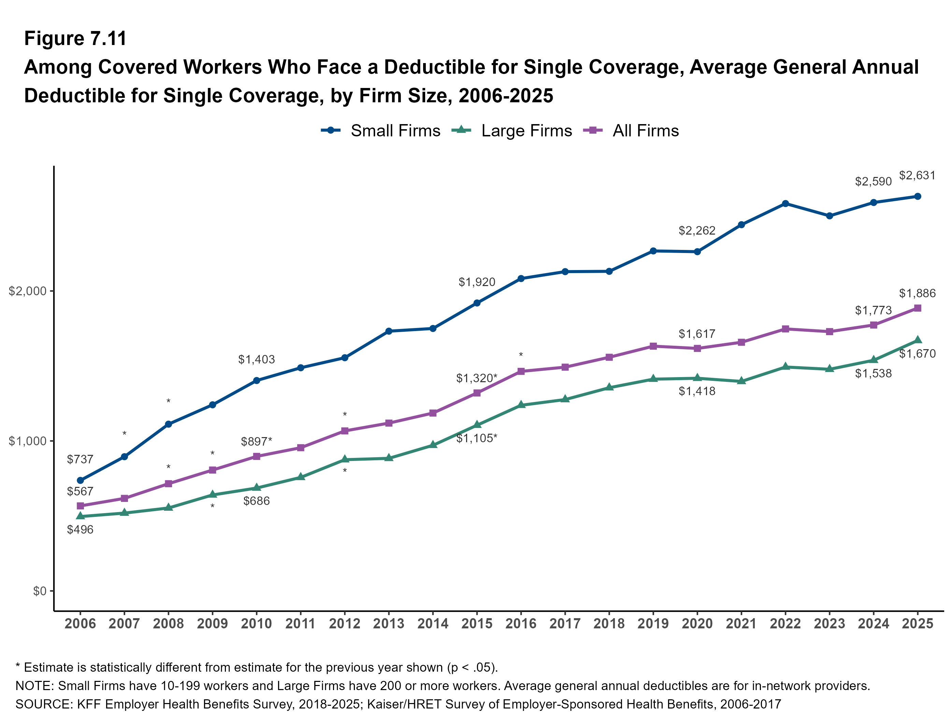
Figure 8
8

Slide 10
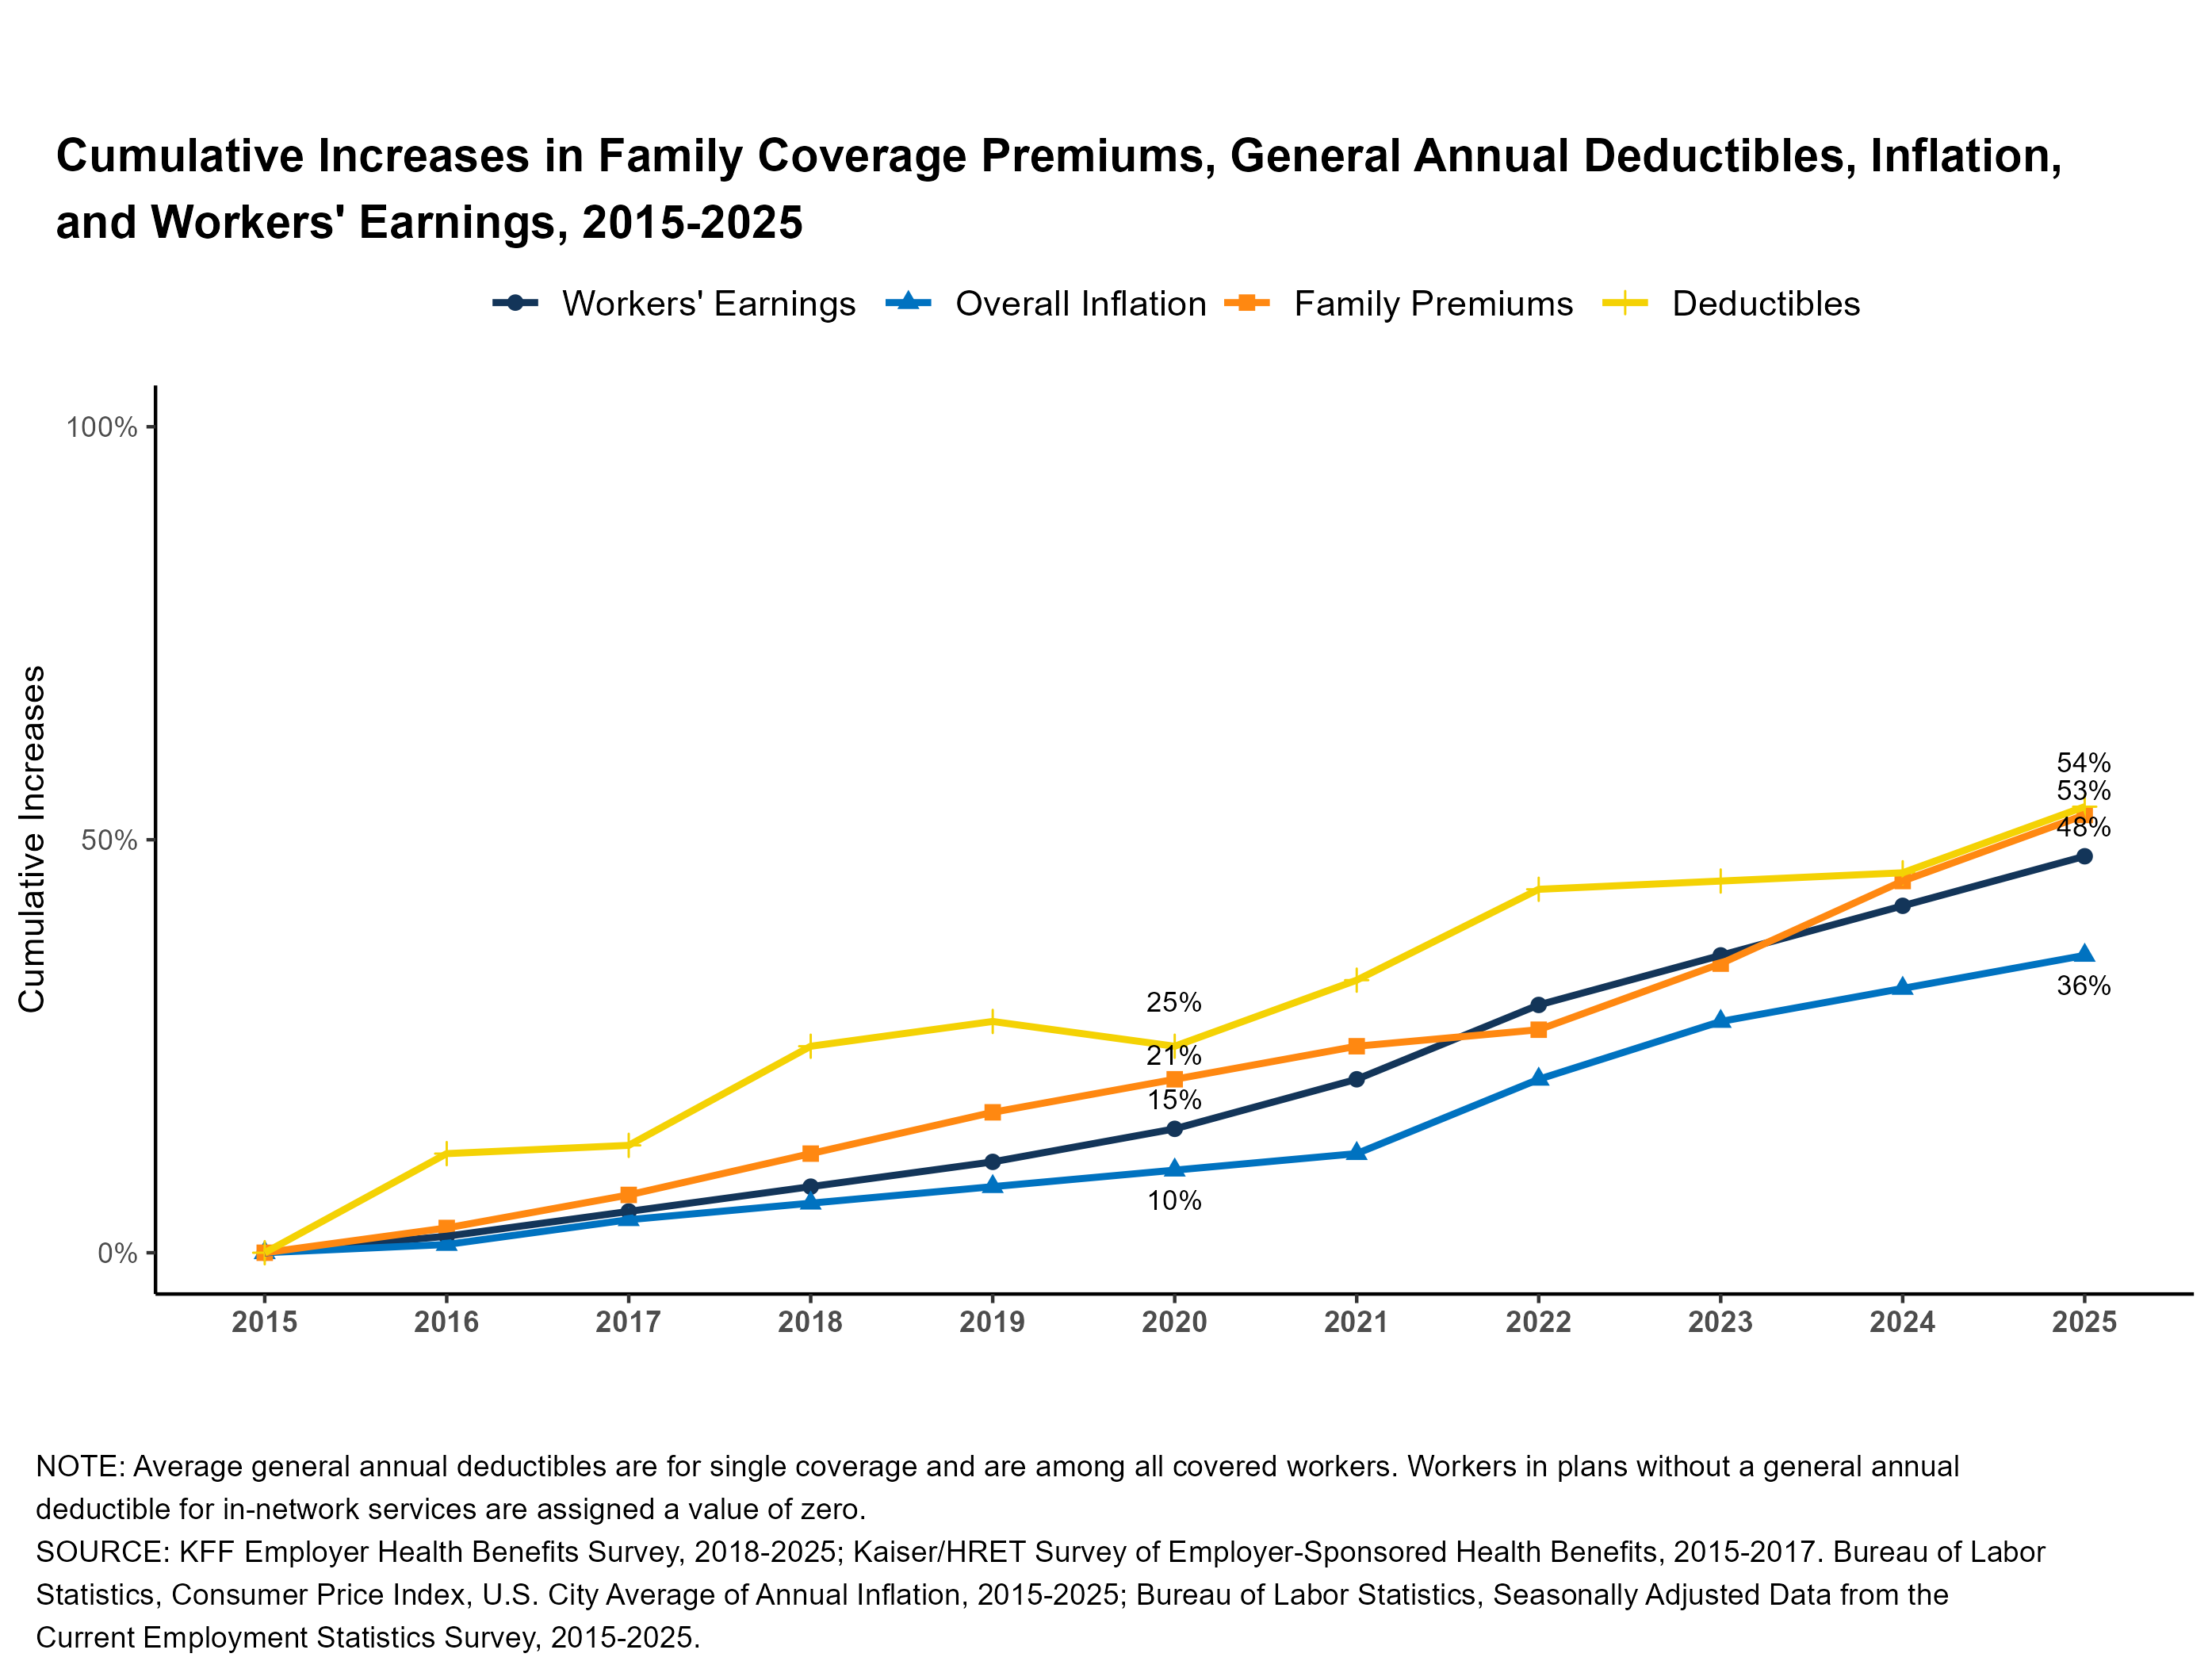
Figure 9
9

Slide 11
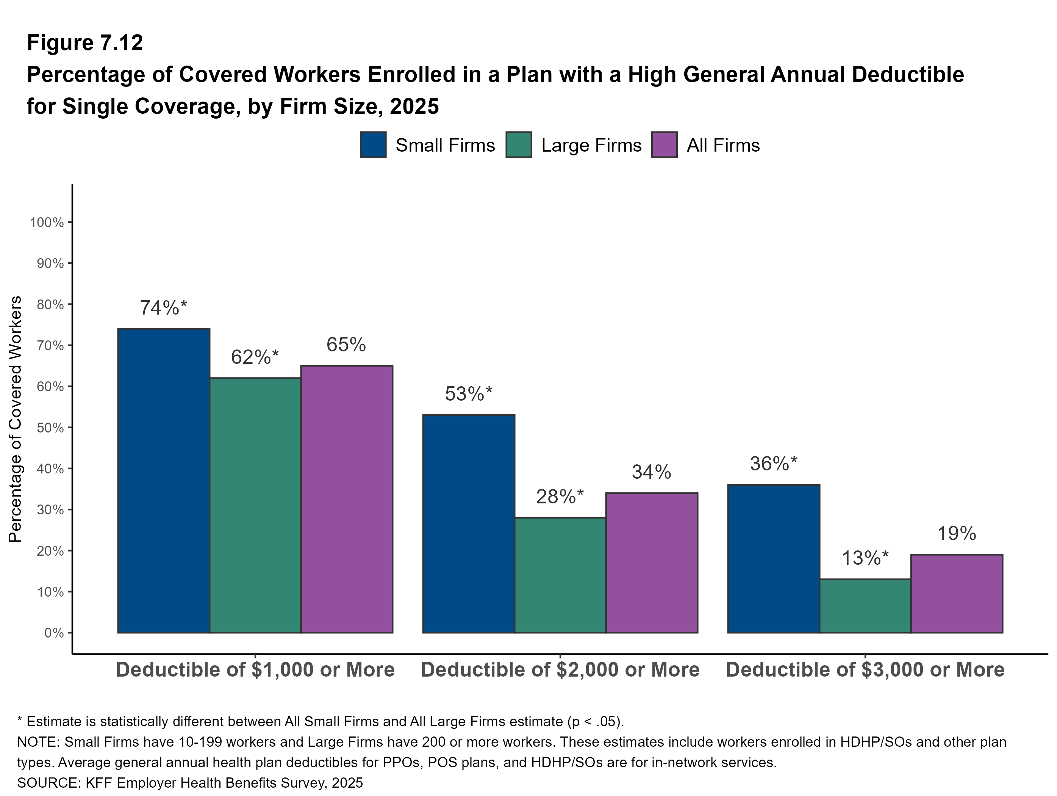
Figure 10
10

Slide 12
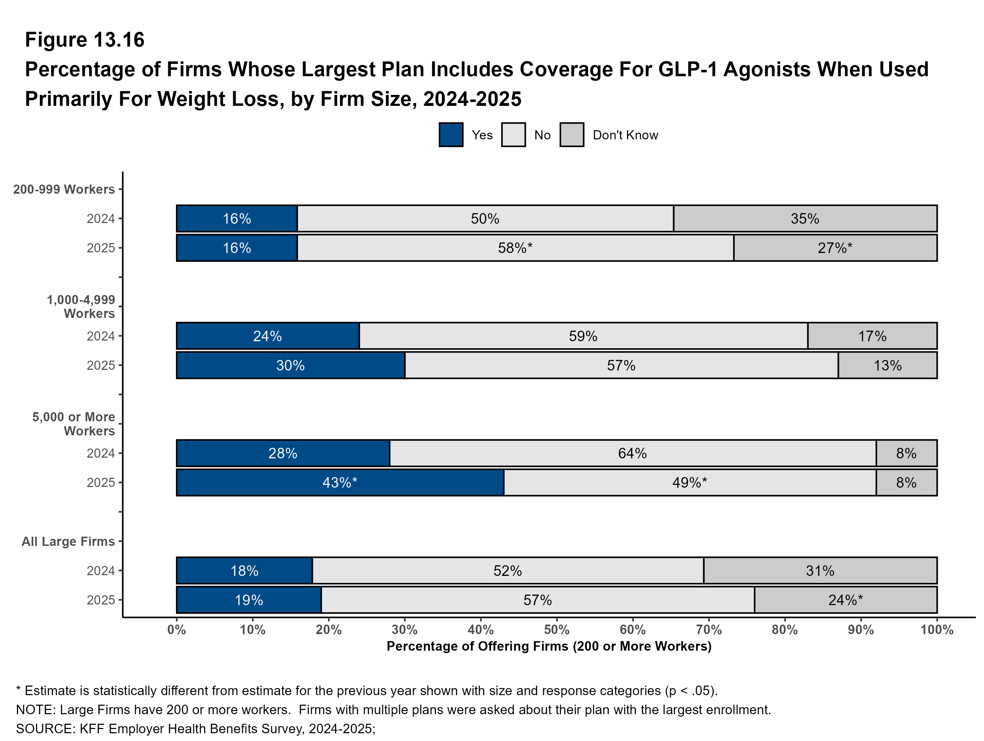
Figure 11

Slide 13
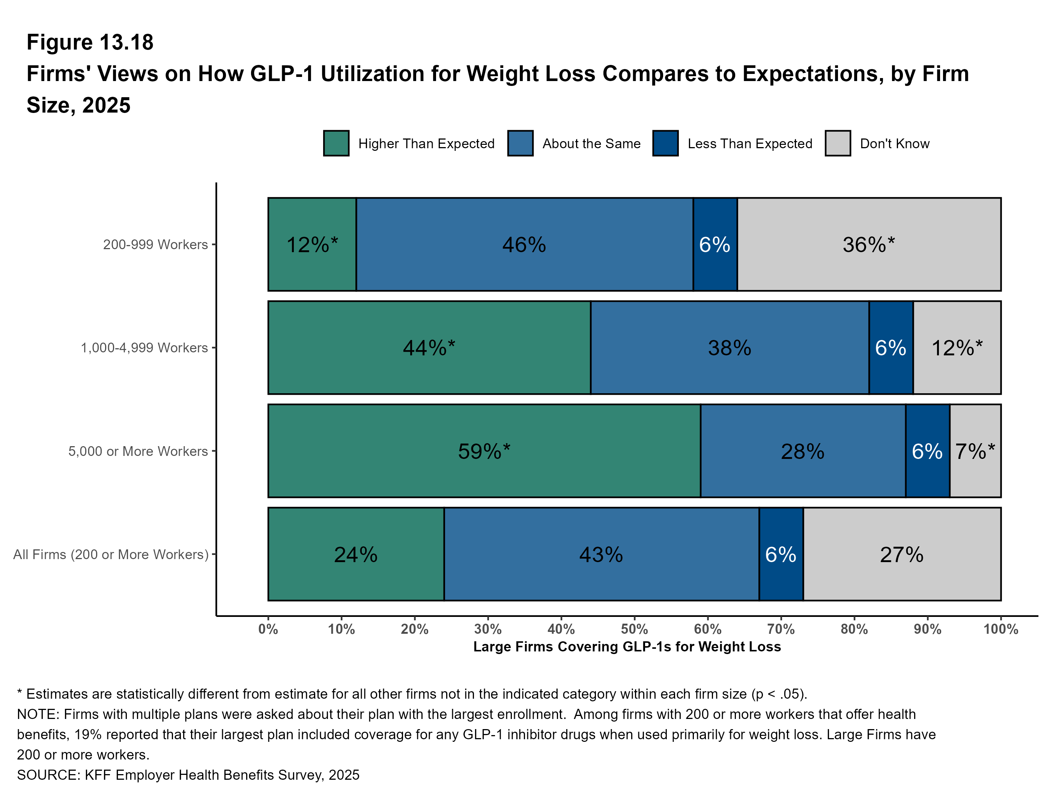
Figure 12

Slide 14
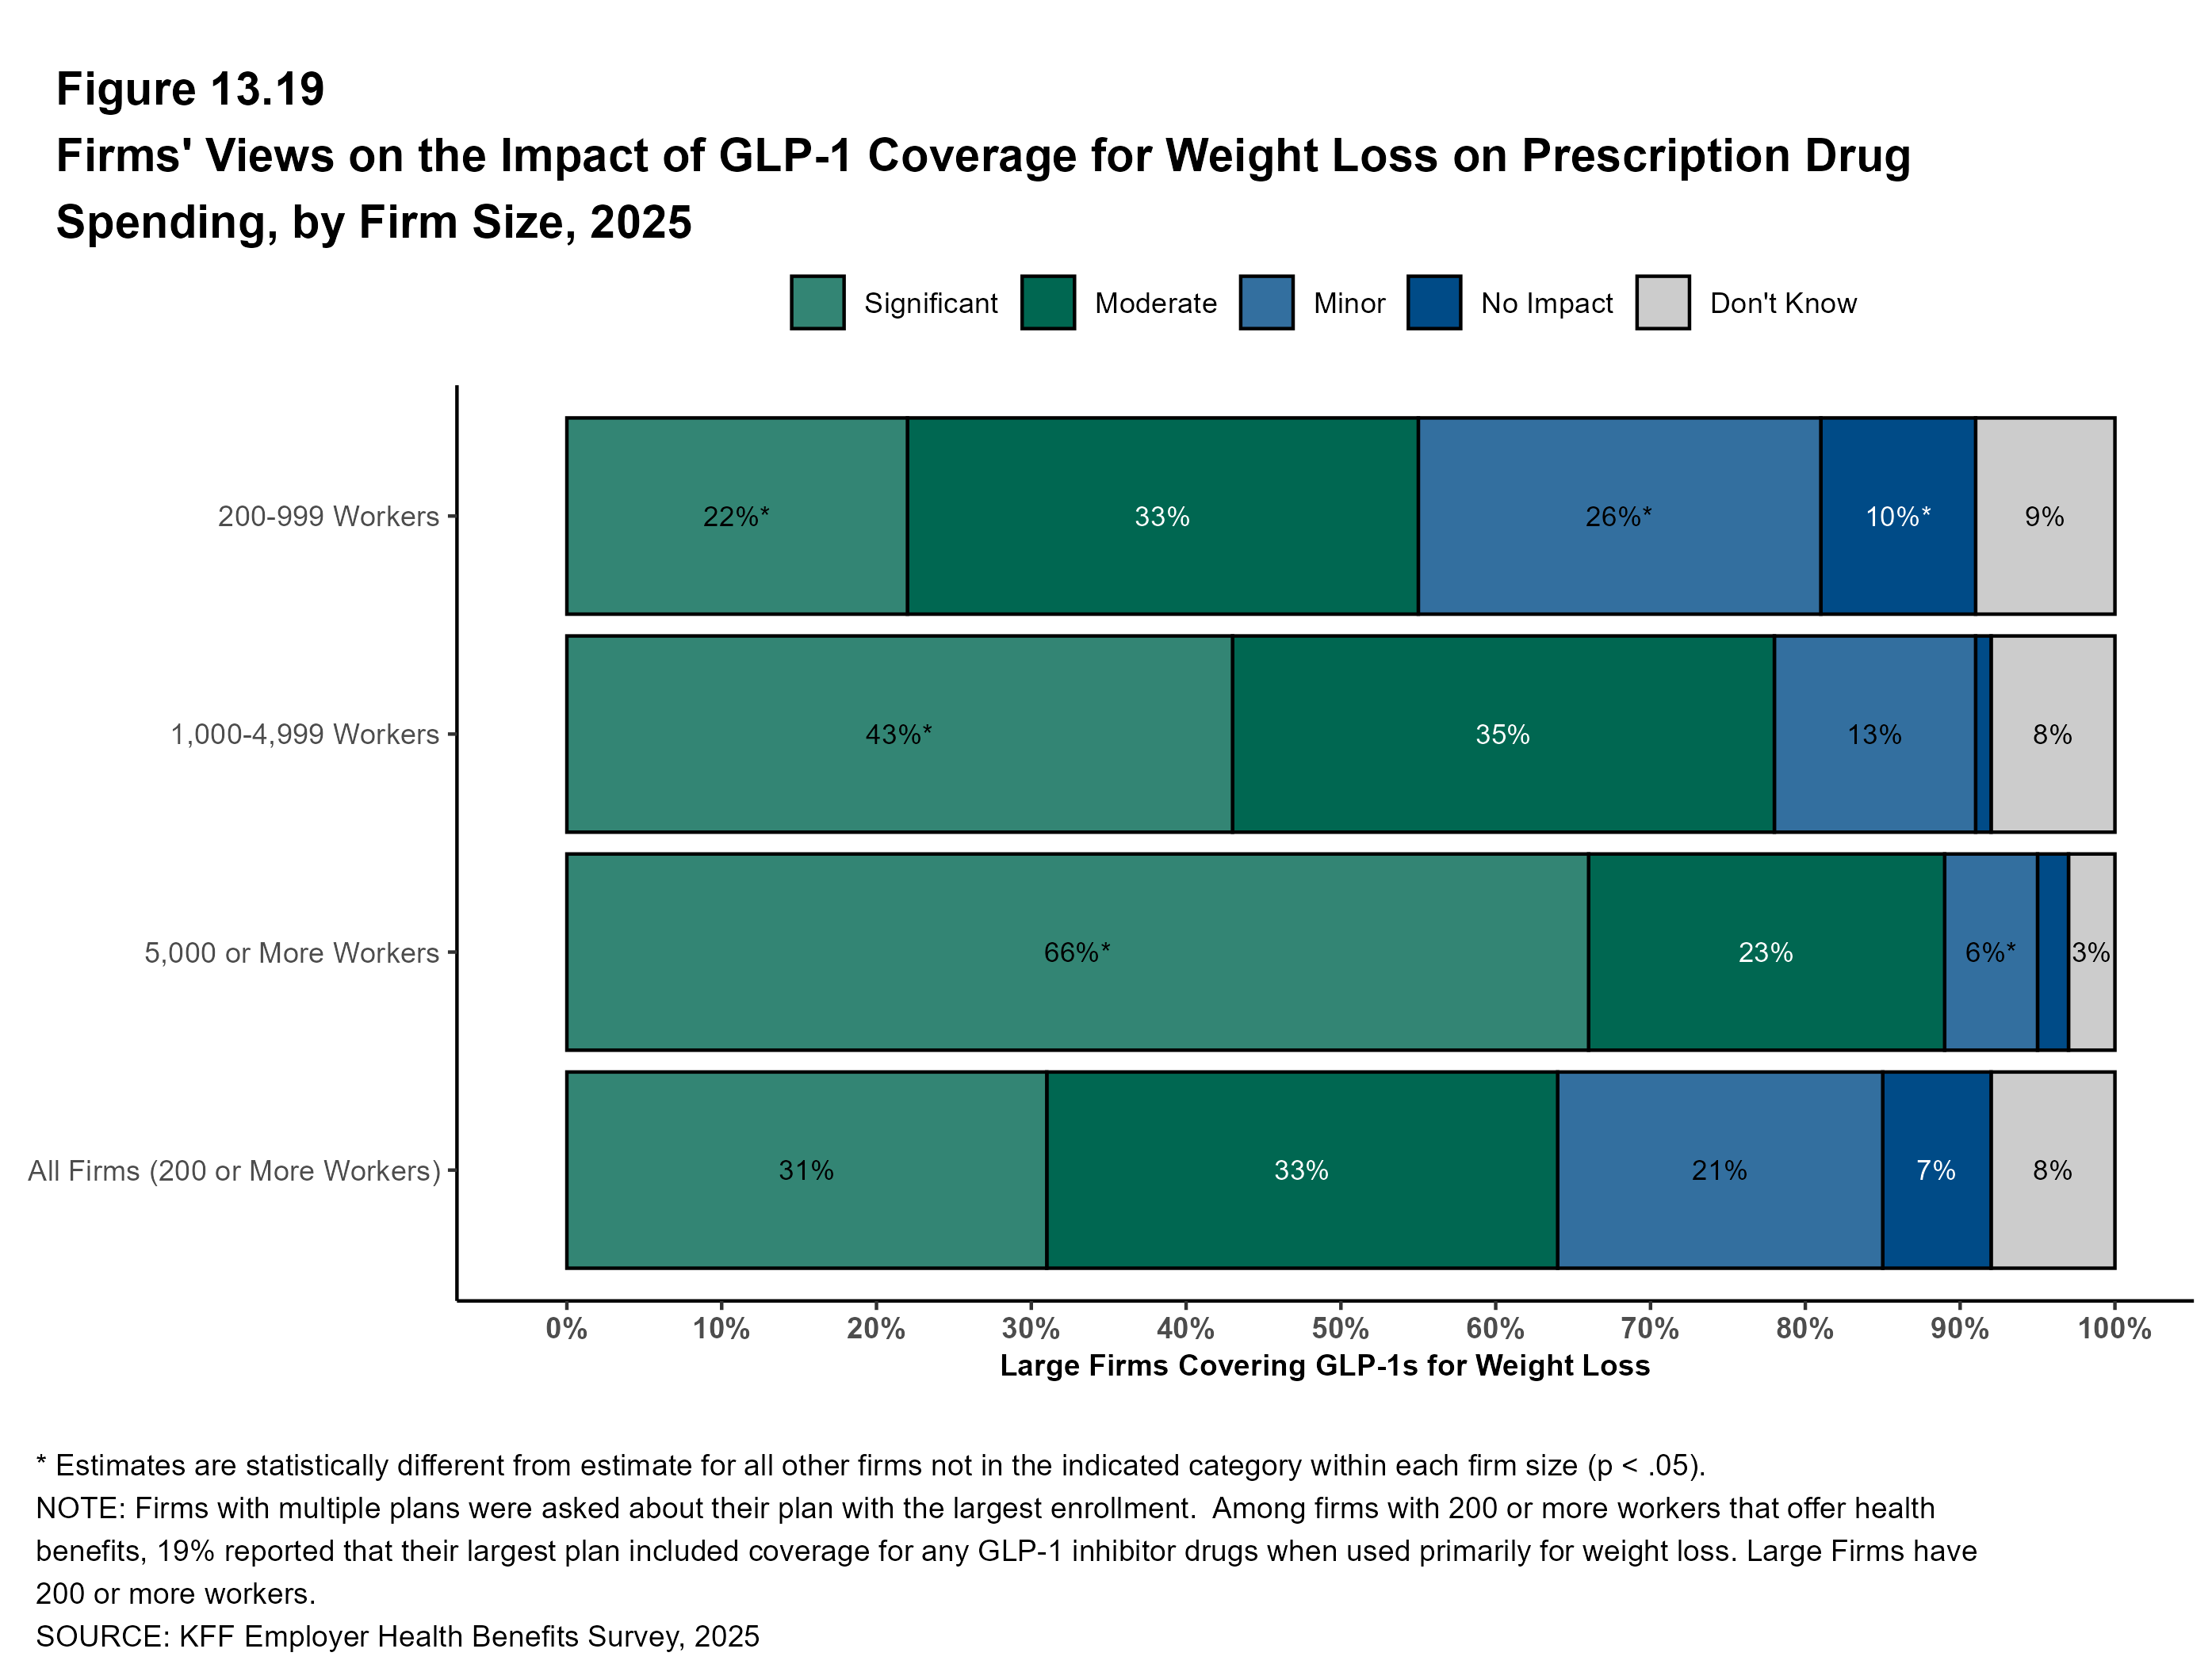
Figure 13

Slide 15
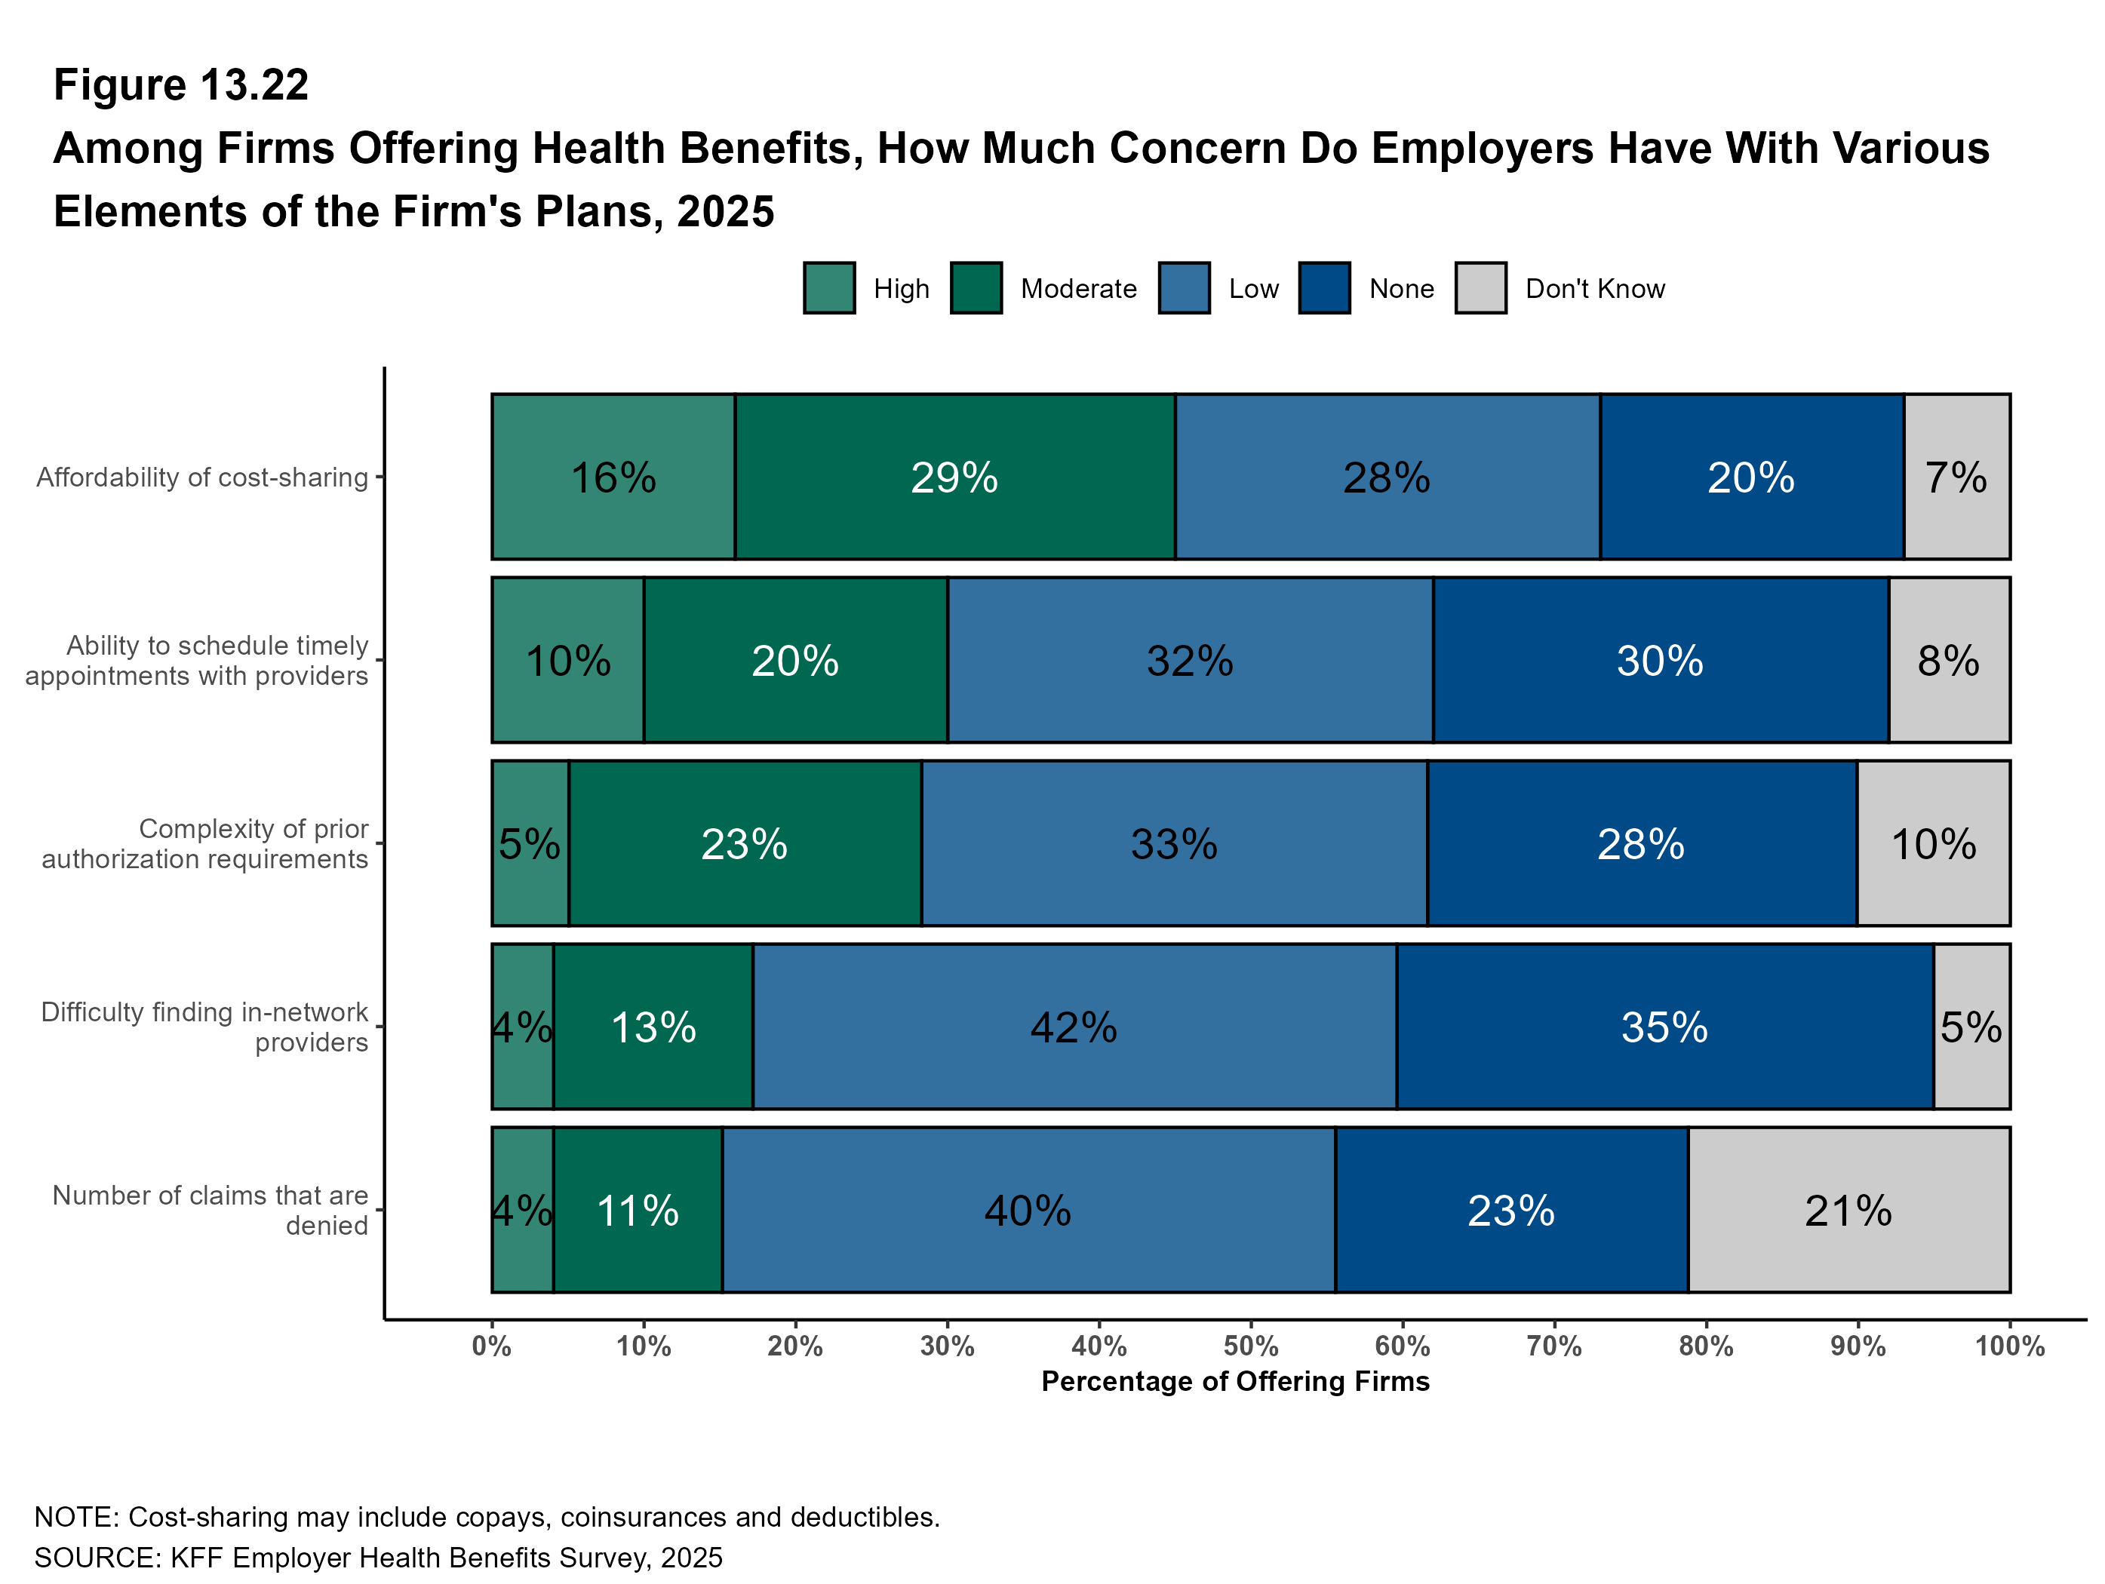
Figure 14

Slide 16
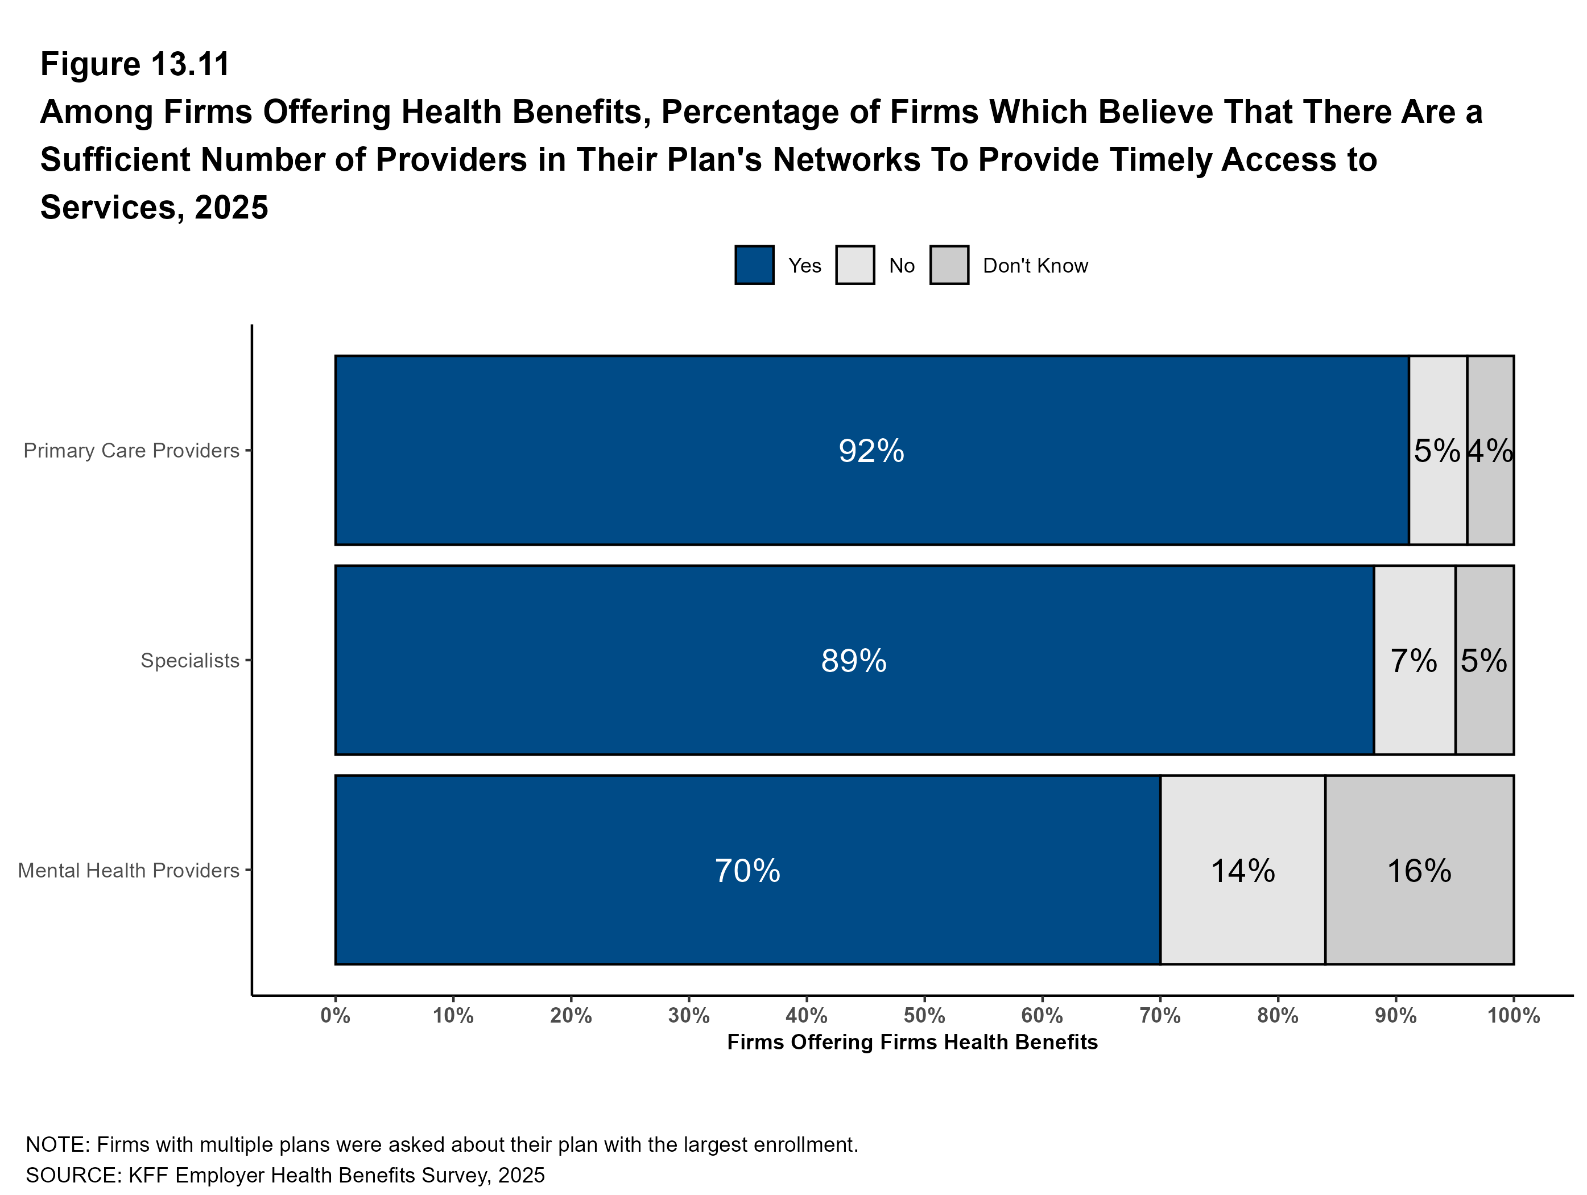
Figure 15

Slide 17
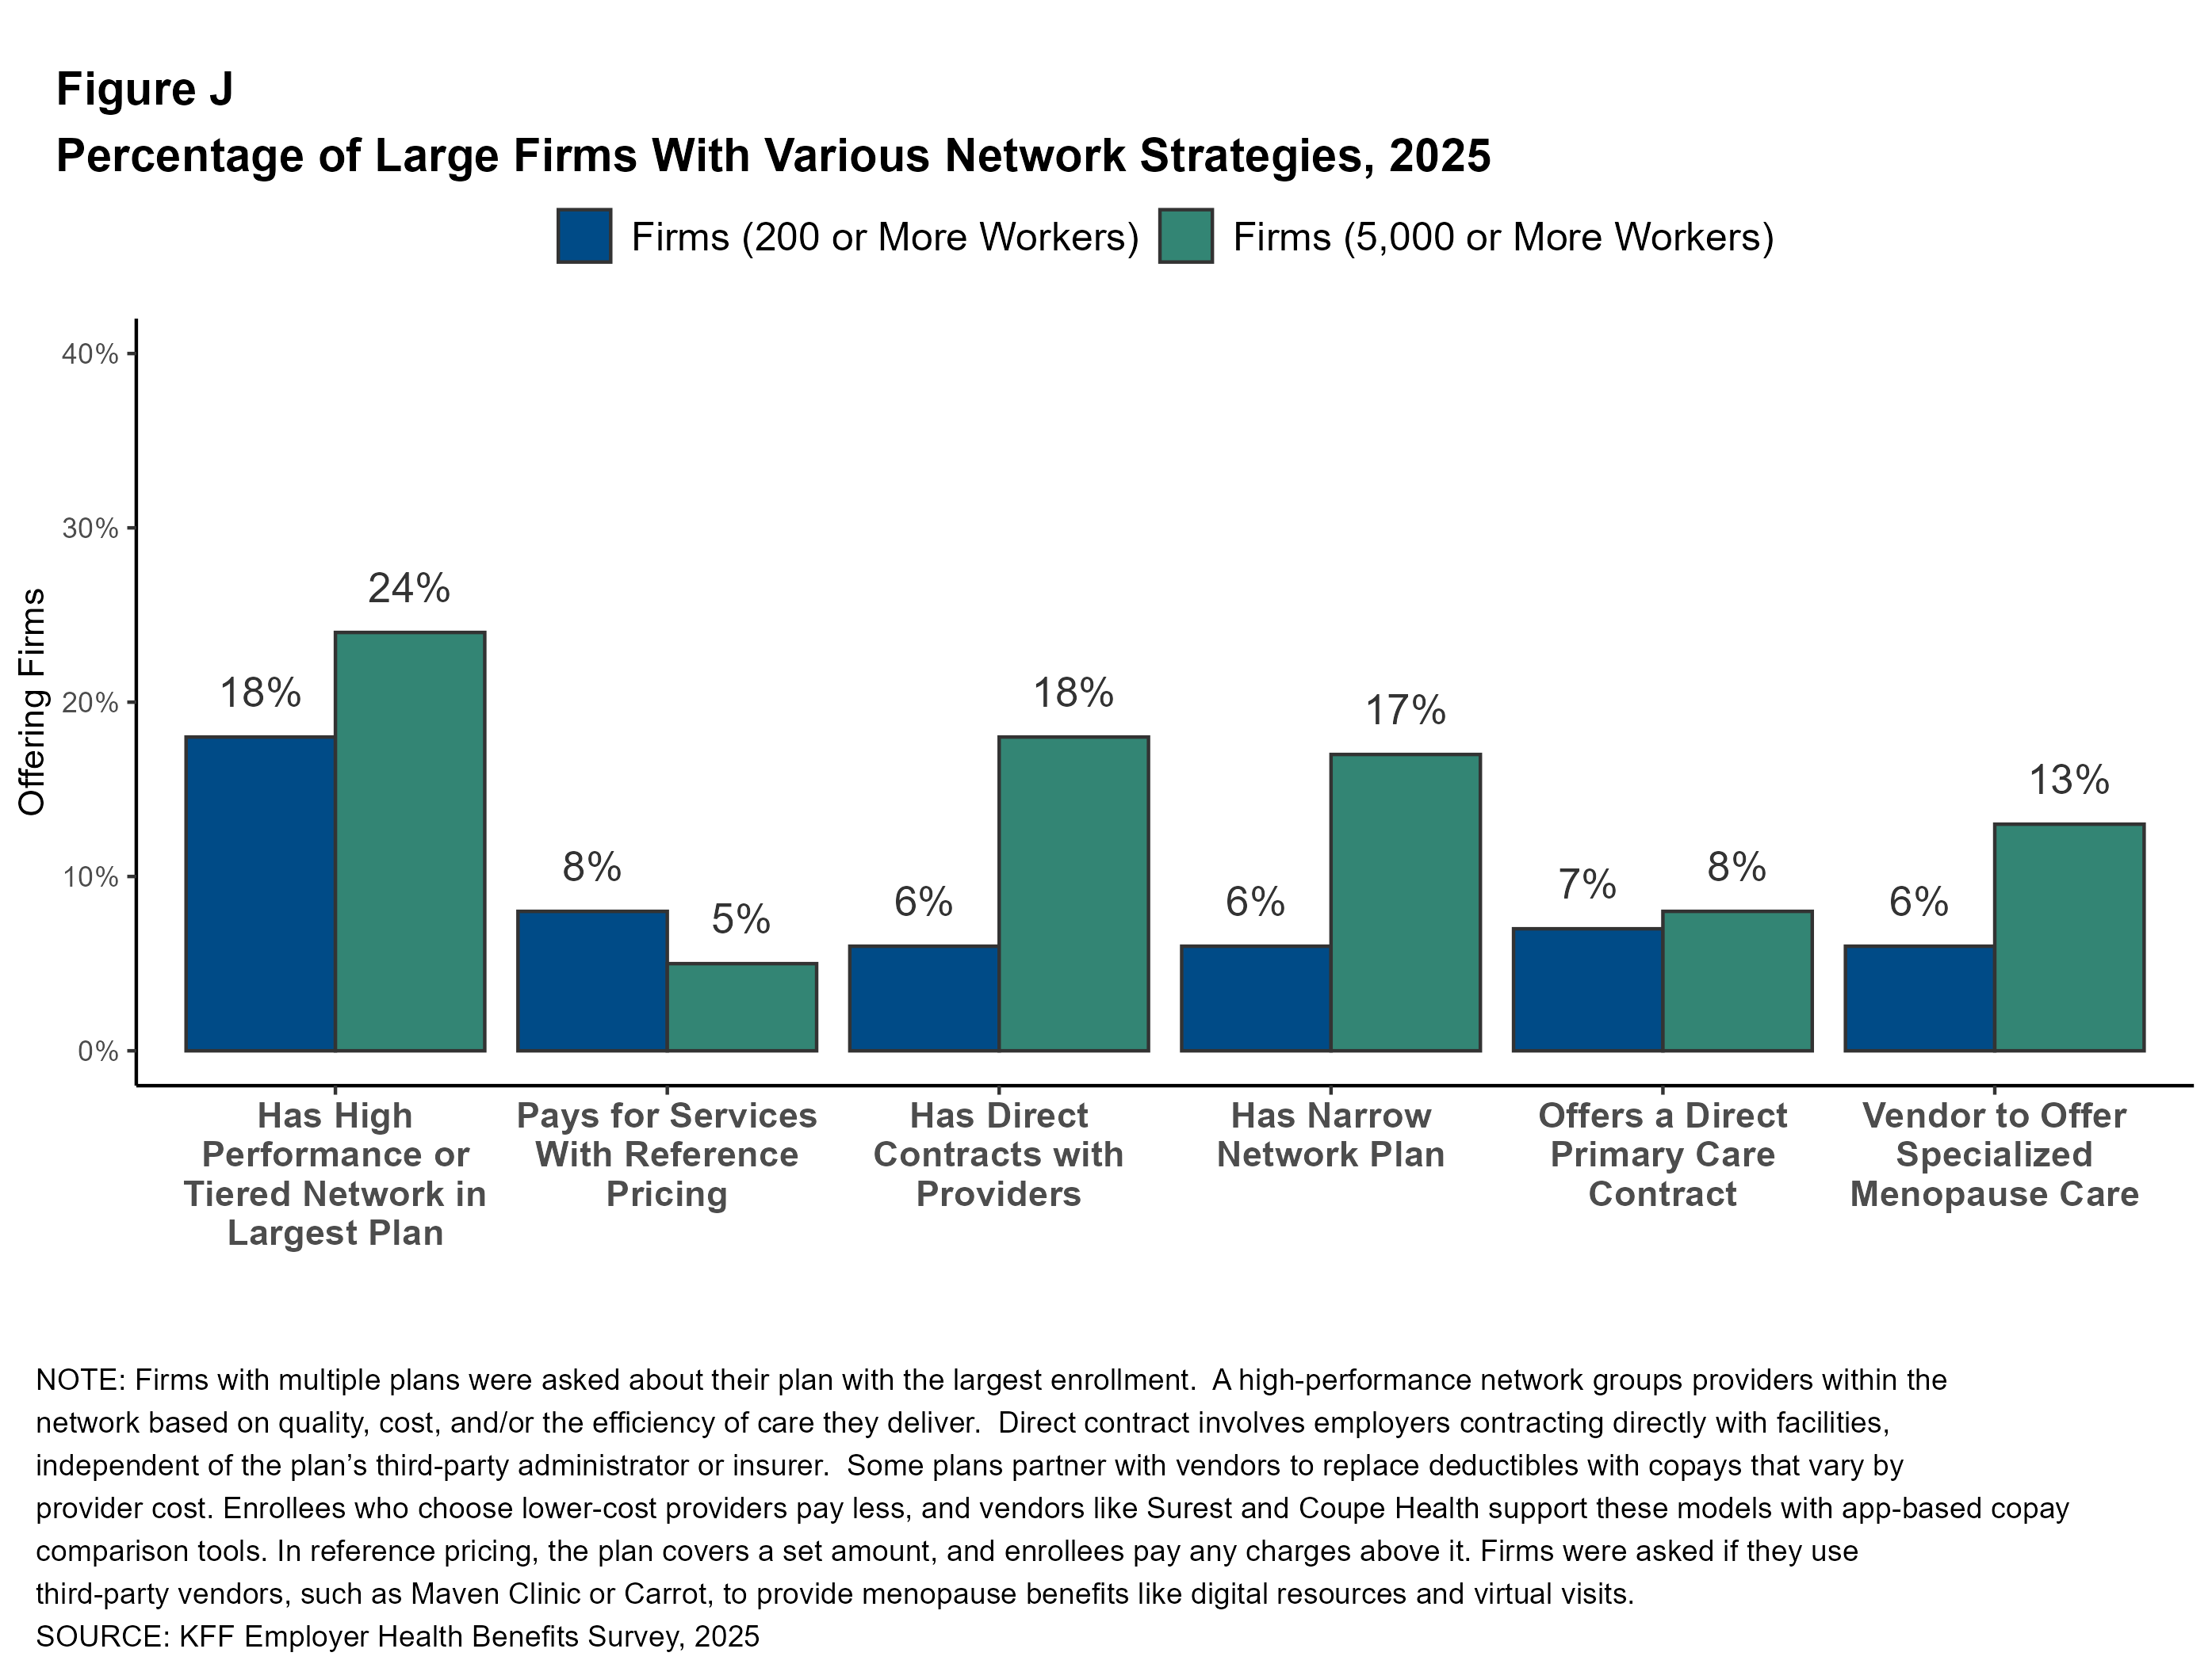
Figure 16

Slide 18
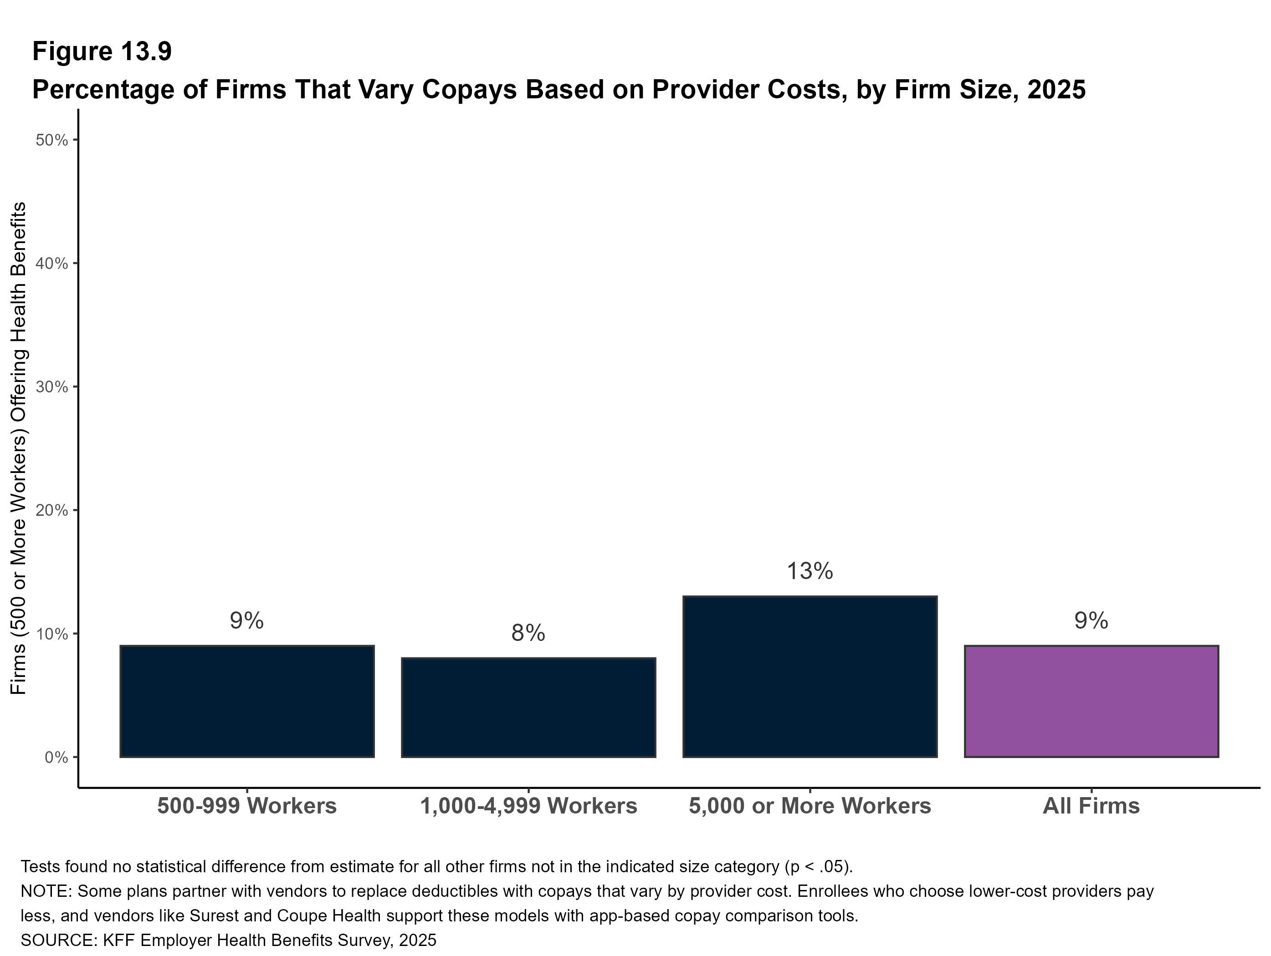
Figure 17

Slide 19
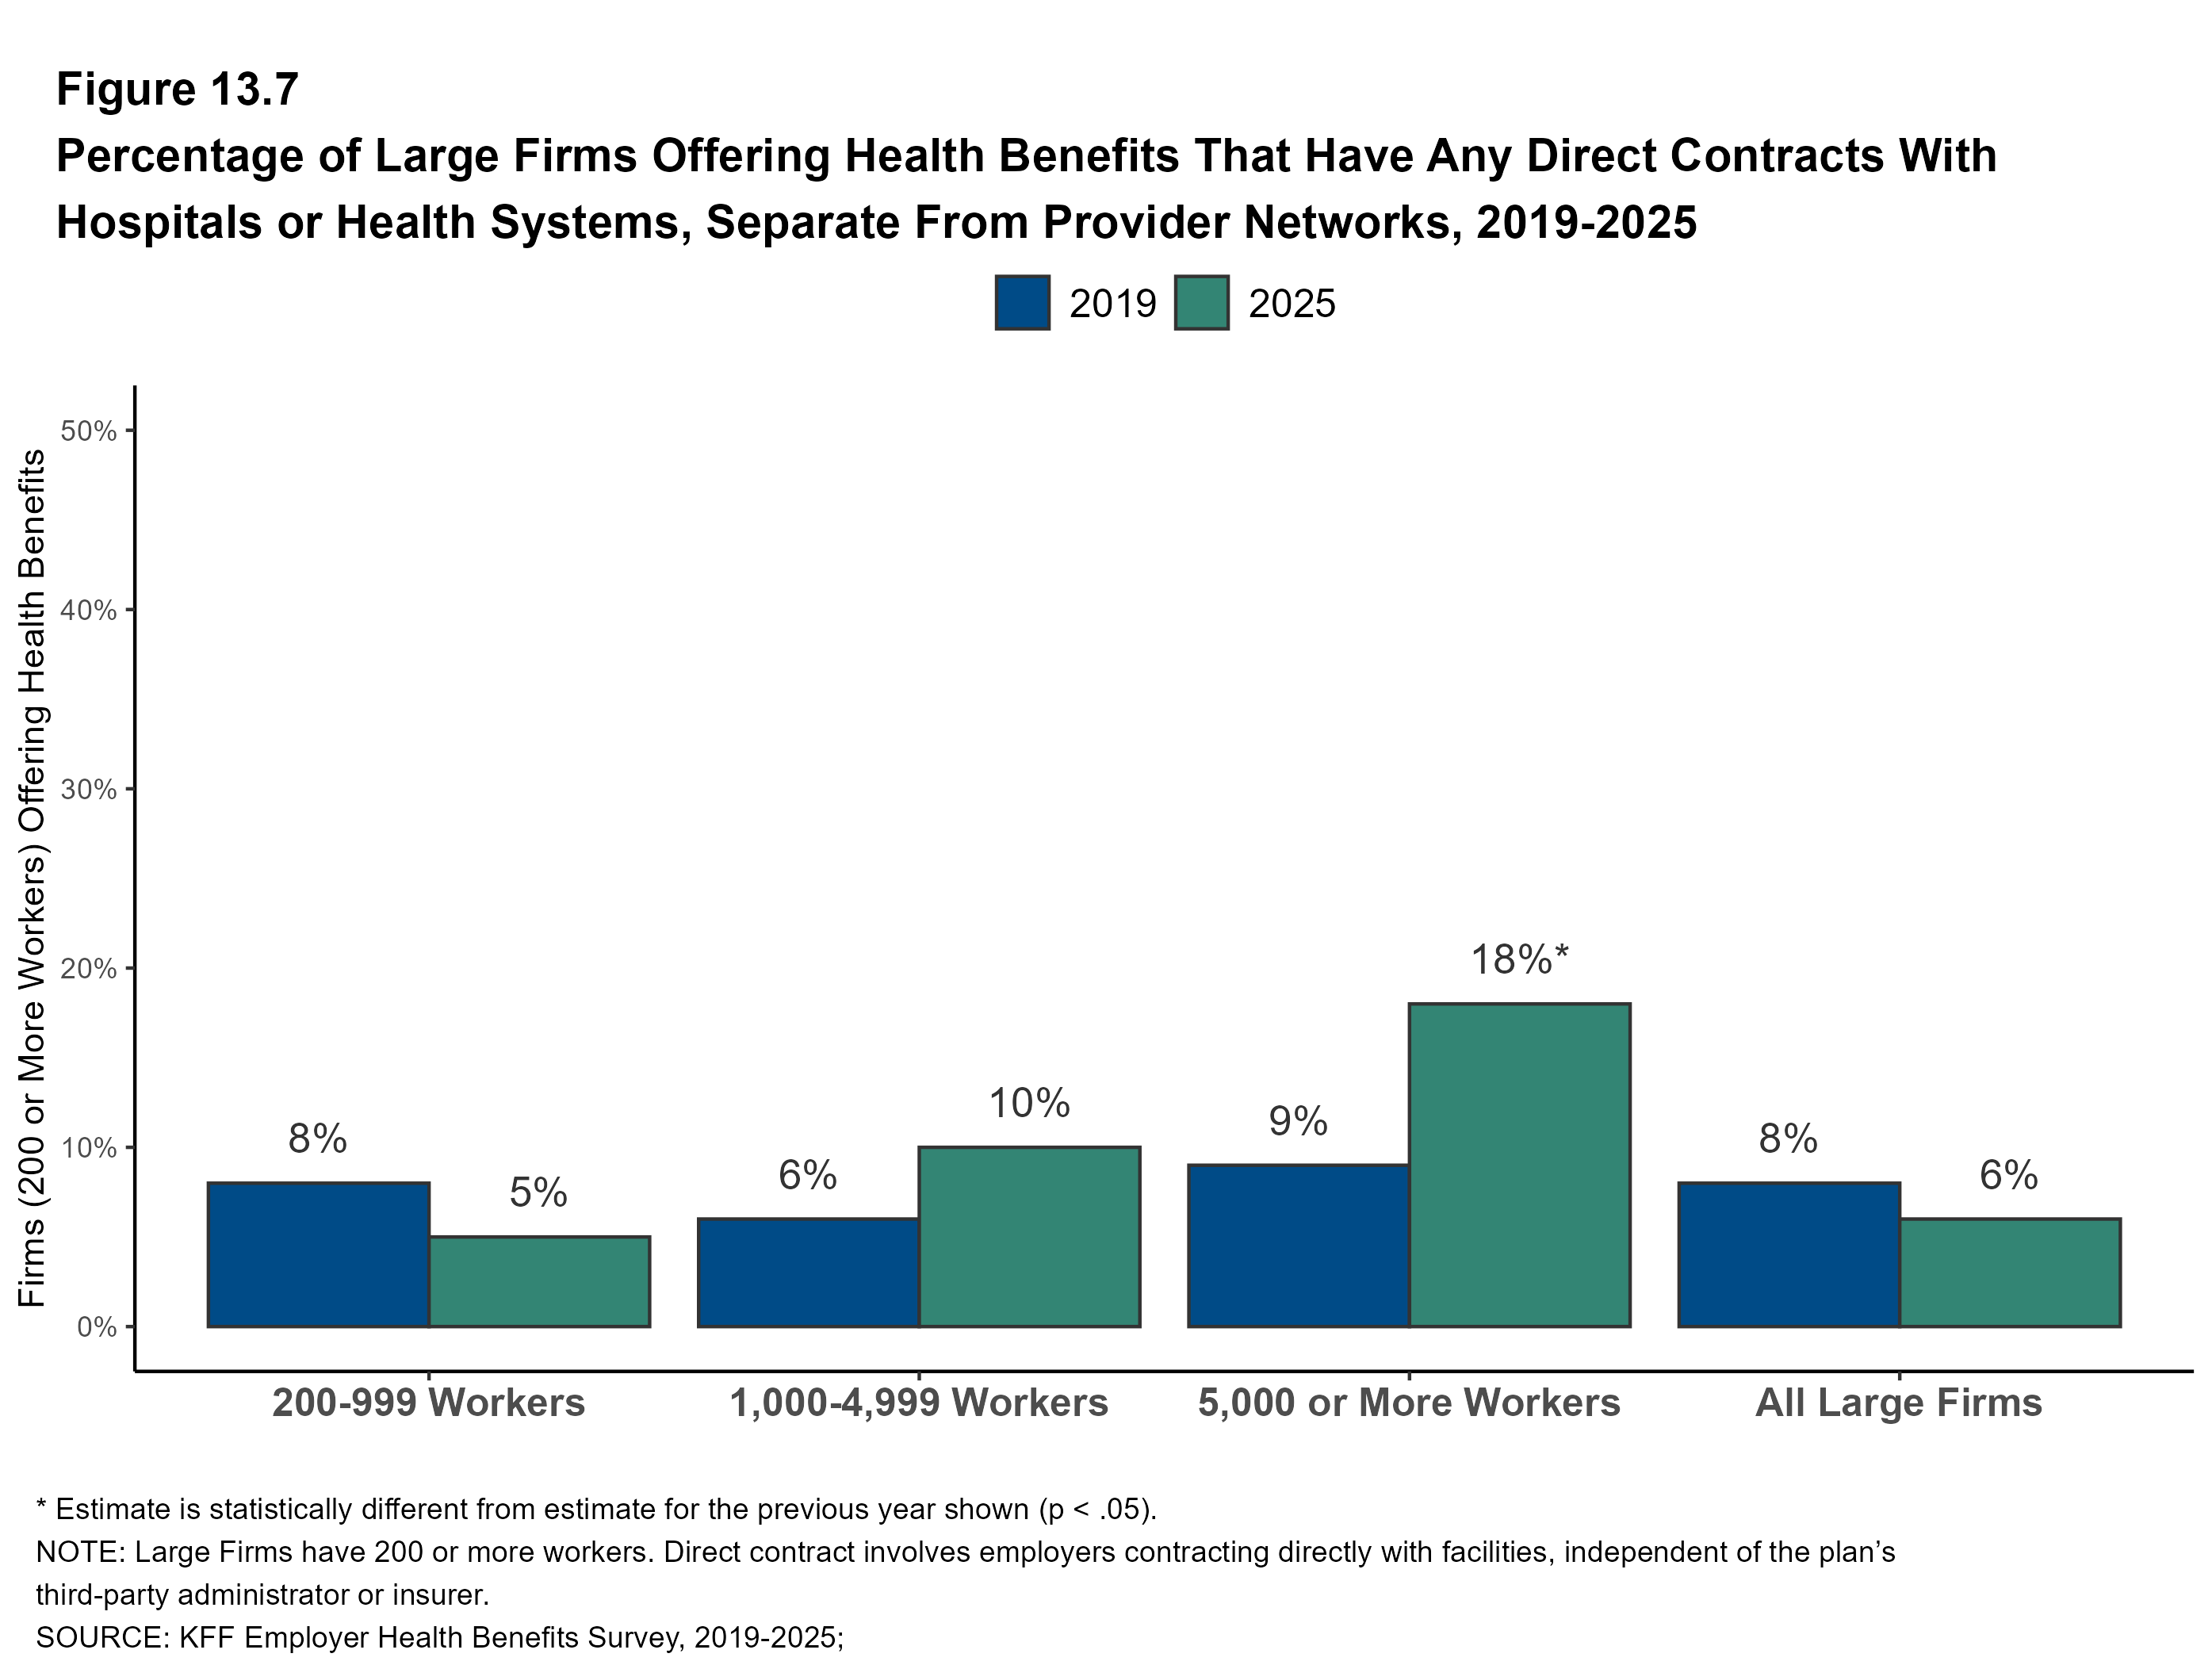
Figure 18

Slide 20
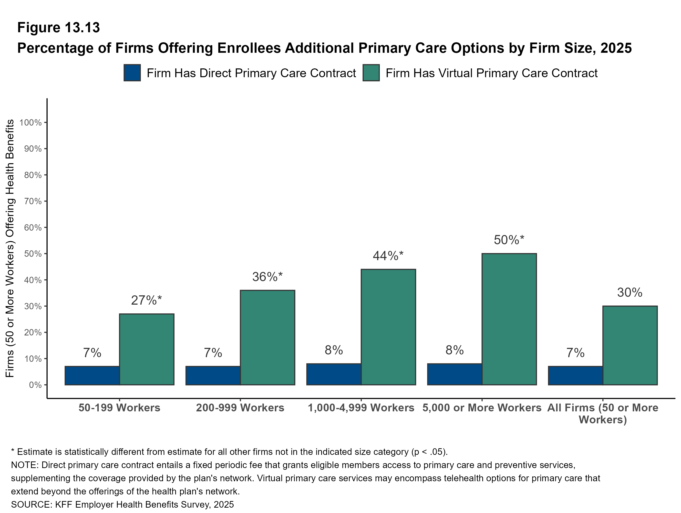
Figure 19

Slide 21
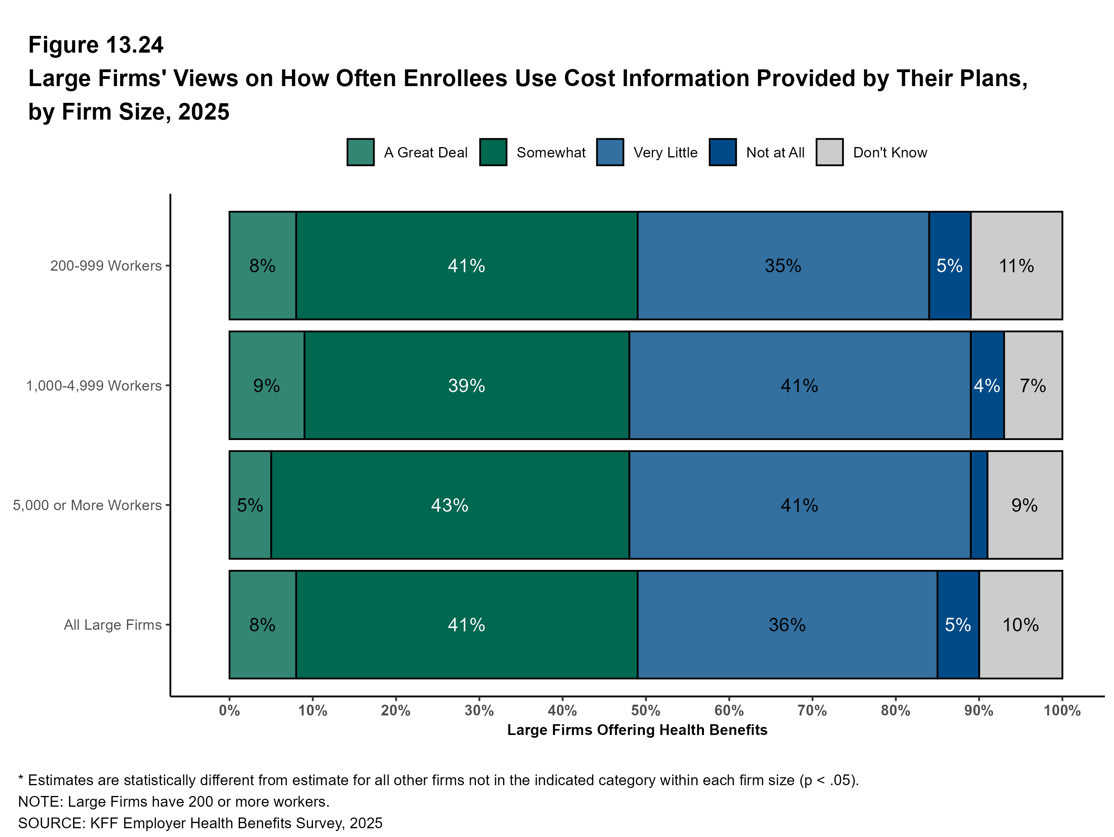
Figure 20

Slide 22
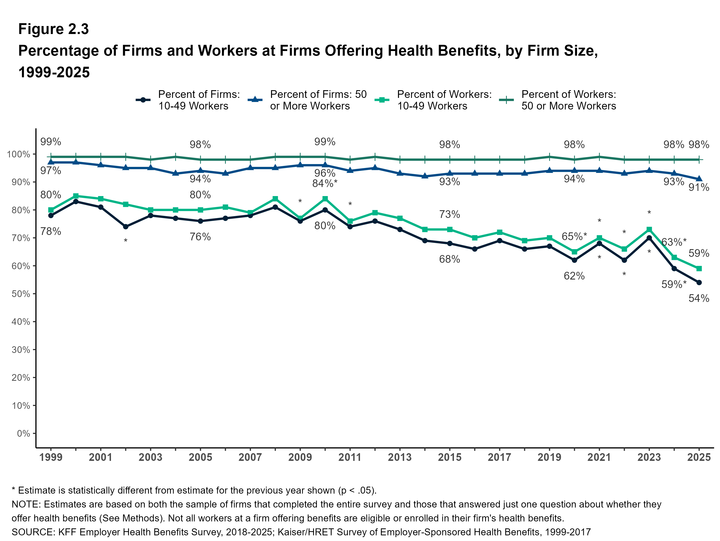
Figure 21
21

Slide 23
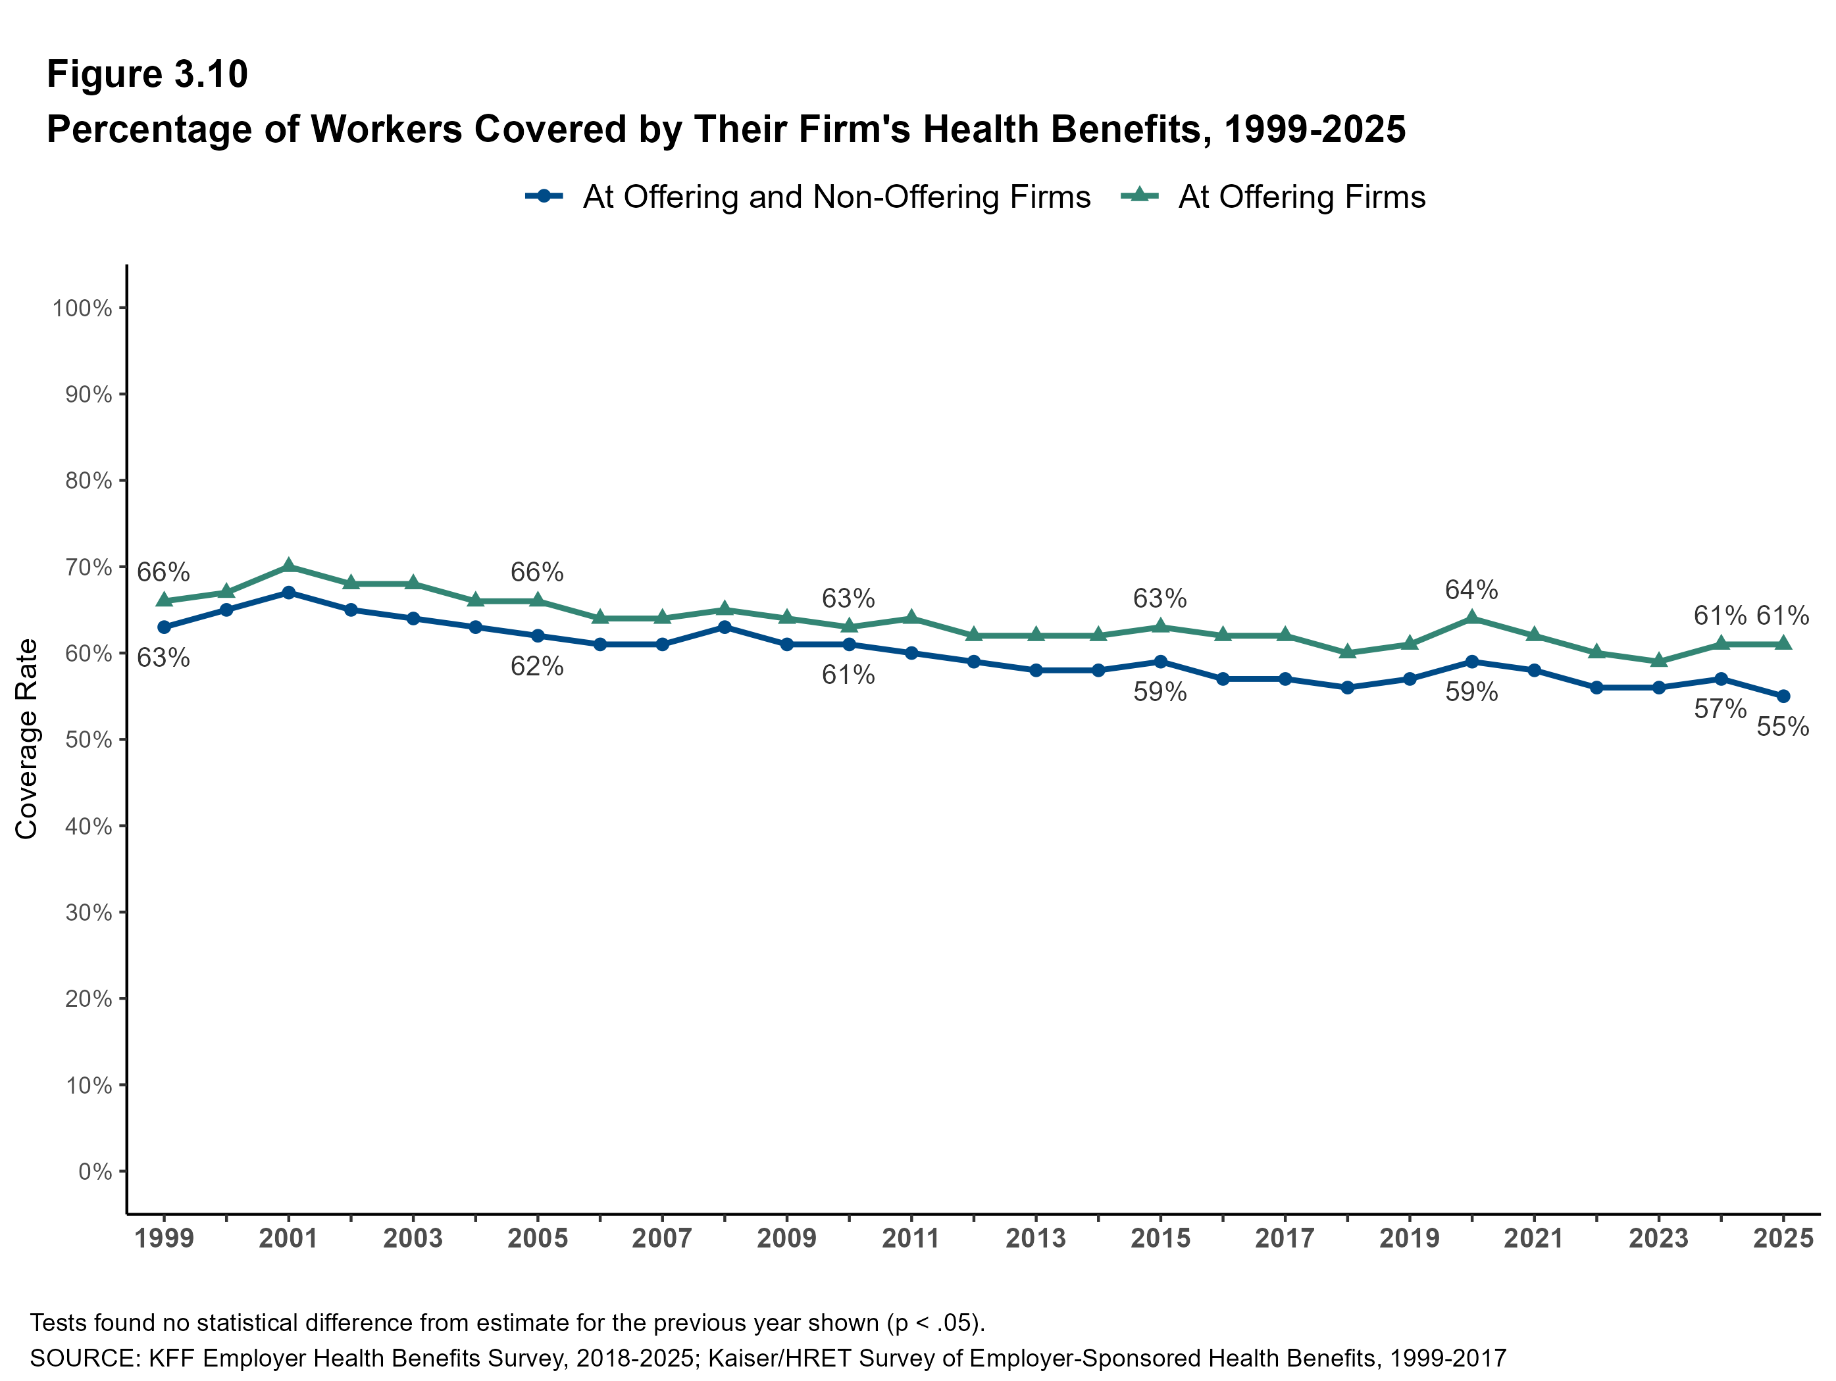
Figure 22
22

Slide 24
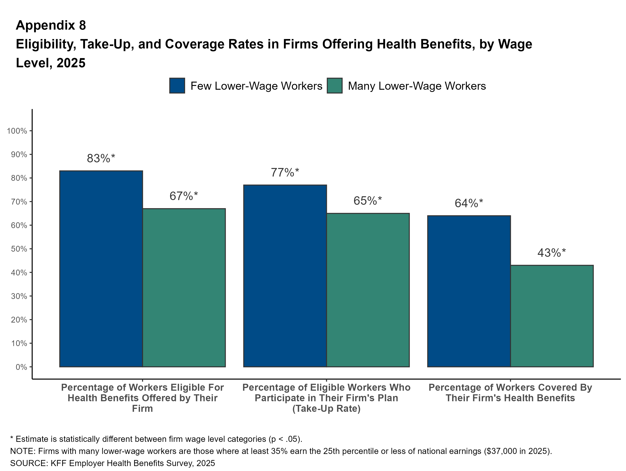
Figure 23
23

Slide 25
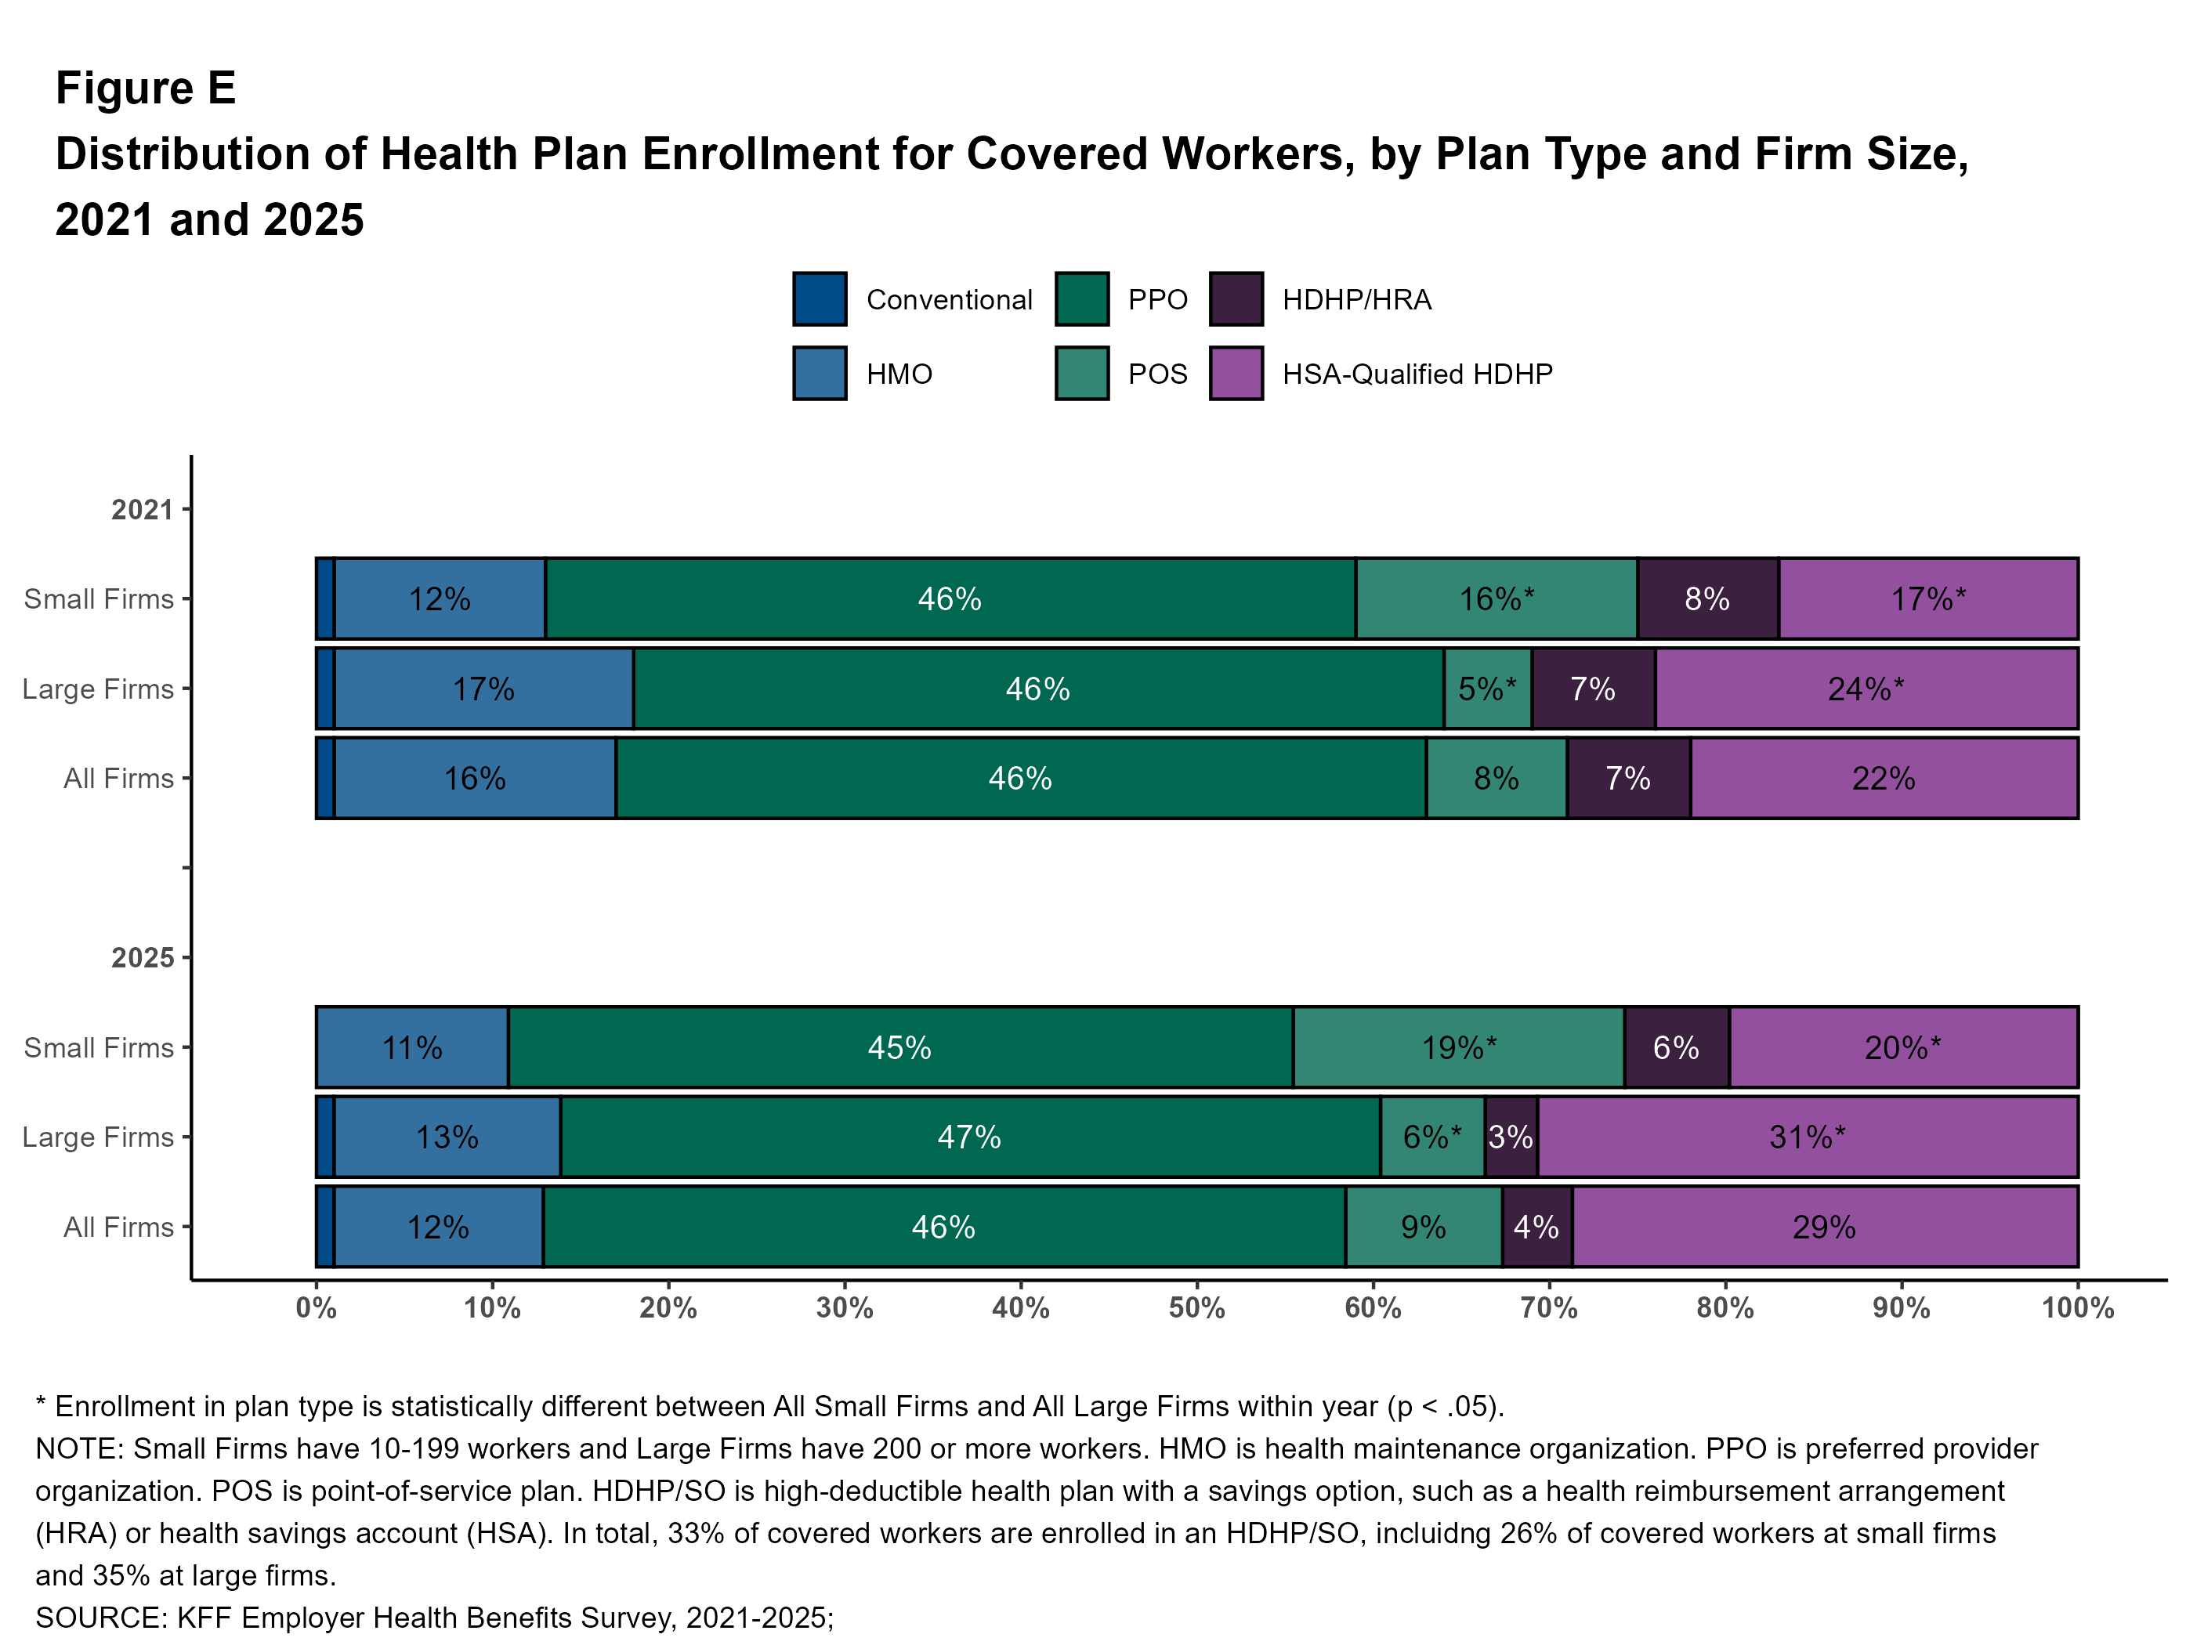
Figure 24

Slide 26
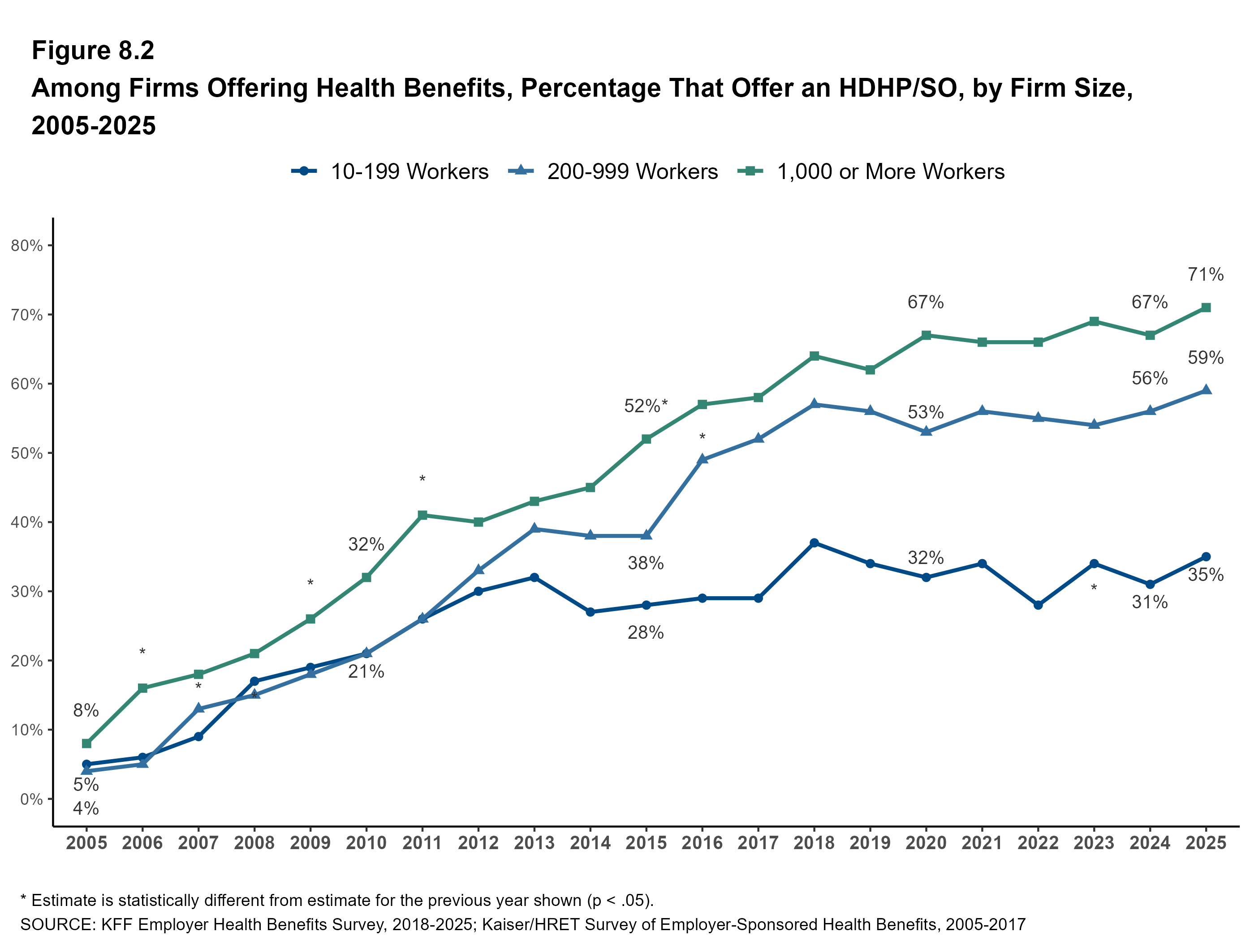
Figure 25

Slide 27
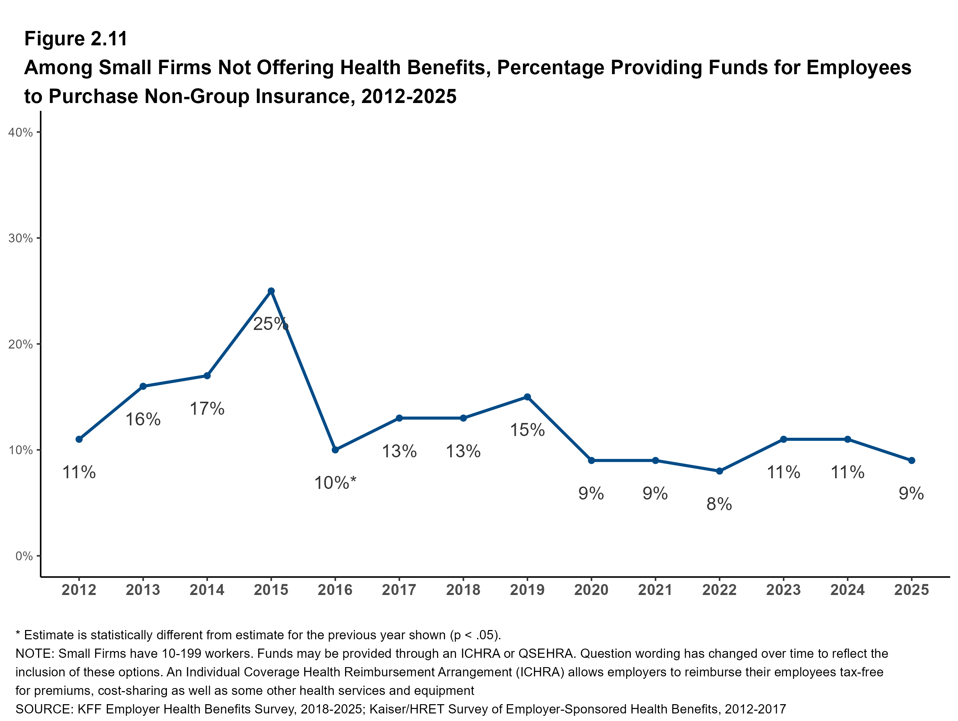
Figure 26
26

Slide 28
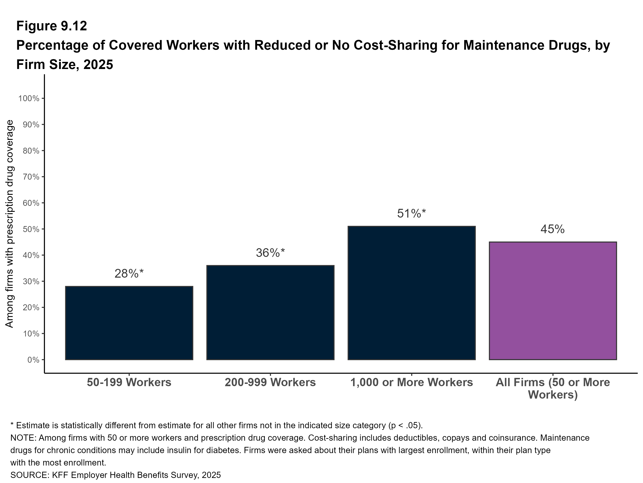
Figure 27

Slide 29
THANK YOU
For more information: Matthew Rae - matthewr@kff.org
See the Report at: www.kff.org/ehbs

