Slide 1
Where Do the Democratic Candidates Stand on Health Reform and Prescription Drug Prices? Tricia Neuman, Wyatt Koma, Karen Pollitz, Jen Tolbert and Sarah True Published February 25, 2020

Slide 2
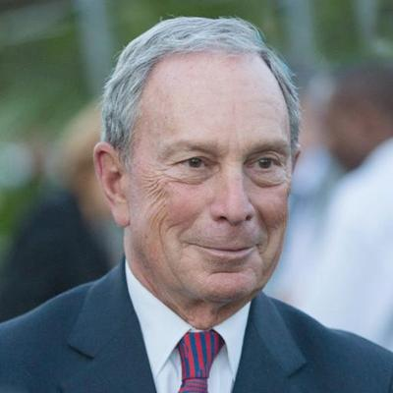
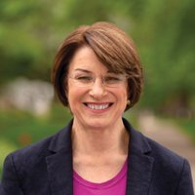
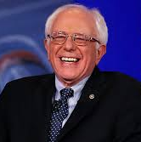
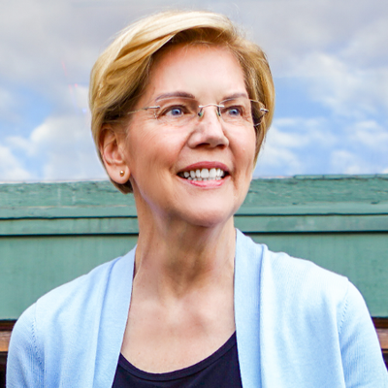
Where do the candidates stand on health reform?
7 Democratic candidates on the debate stage: February 25, 2020
Joe
Biden
Michael
Bloomberg
Pete
Buttigieg
Amy
Klobuchar
Bernie
Sanders
Tom
Steyer
Elizabeth
Warren

Slide 3
A few caveats...
These slides focus solely on the 7 Democratic presidential candidates who qualified to be on the debate stage February 25, 2020
Some of the candidates’ positions are more detailed than others
Positions are based on campaign websites

Slide 4
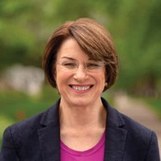
Which candidates are for Medicare-for-all versus a public option with ACA improvements?
Medicare-for-all
Public Option with ACA improvements
Medicare-for-all
Public Option
Elizabeth Warren
has 2 proposals
SOURCE: KFF analysis of Medicare-for-all or public option proposals posted on each candidate’s campaign website, as of 2/24/2020.

Slide 5
What are the key differences between Medicare-for-all and public option proposals?
Medicare-for-all
Public Option
Creates new “Medicare” government-administered program for all Americans
Replaces Medicare, Medicaid, employer & marketplace insurance
No premiums or deductibles; virtually no cost sharing
Comprehensive benefits, including long-term services and supports (LTSS)
Creates new government-administered public option
Retains Medicare, Medicaid, employer & marketplace insurance
Enhances subsidies in marketplace and public option
Proposals vary by:
Eligibility for the public option
Auto-enrollment of certain groups
Benefits
Treatment of Medicare & Medicaid
Premium & subsidy calculation in ACA and public option
Payments to providers
SOURCE: KFF analysis of Medicare-for-all or public option proposals posted on each candidate’s campaign website, as of 2/24/2020.

Slide 6
Does Elizabeth Warren support Medicare-for-all or a public option?
Answer: Both.
Phase 1: Public Option
(First 100 Days)
Phase 2: Medicare-for-all
(Third Year of First Term)
Public Option
Medicare-for-all
Creates a federal public option and auto enrolls all children, adults <200% of poverty under age 50, uninsured, with opt out
Initially, no premiums/cost sharing <200% of poverty; premiums capped at 5% of income for others; premiums/cost sharing eliminated for everyone over time
Retains current coverage sources; allows states to move Medicaid enrollees into the public option with maintenance-of-effort payment
Lowers Medicare eligibility to age 50; expands benefits; caps out-of-pocket spending at $1,500 annually
Creates a new “Medicare” government-administered program for all U.S. residents
Replaces Medicare, Medicaid, employer-sponsored coverage, private insurance, and marketplace insurance with Medicare-for-all with no premiums, deductibles, or cost sharing with comprehensive benefits, including long-term services and supports, vision, hearing and dental
SOURCE: KFF analysis of Medicare-for-all or public option proposals posted on each candidate’s campaign website, as of 2/24/2020.

Slide 7
What happens to employer-sponsored and private insurance under Medicare-for-all or public option proposals?
Medicare-for-all replaces employer-sponsored and private insurance
Public option proposals retain employer-sponsored and private insurance
Medicare-for-all
Public Option
Biden, Buttigieg, Steyer and Warren allow employees to opt into the public option and receive subsidies
SOURCE: KFF analysis of Medicare-for-all or public option proposals posted on each candidate’s campaign website, as of 2/24/2020.

Slide 8
How do Medicare-for-all or public option proposals affect the current Medicare program?
No change to Medicare benefits or eligibility
Retains Medicare; Adds optional vision, hearing, dental benefit
Retains Medicare, adds a cap on out-of-pocket spending
Lowers Medicare eligibility to age 50, auto enrolls low-income 50-64 year olds; adds cap on out-of-pocket spending & other benefits
Replaces current Medicare with Medicare-for-all, with enhanced benefits, no premiums, deductibles, or cost sharing
Public Option
Medicare-for-all
NOTE: All candidates have proposals to address Medicare prescription drug costs. Buttigieg would also enhance Medicare provider payment rates in underserved areas. The Sanders proposal allows cost sharing up to $200 for prescription drugs. Klobuchar supports expanding Medicare to cover dental, vision, and hearing benefits.
SOURCE: KFF analysis of Medicare-for-all or public option proposals posted on each candidate’s campaign website, as of 2/24/2020.

Slide 9
What happens to the current Medicaid program?
Replaces Medicaid
Modifies Medicaid
Medicare-for-all
Public Option
Sanders retains Medicaid for nursing home & other institutional long-term care services; requires maintenance of effort for state institutional long-term care spending
Warren replaces Medicaid & includes long-term care as a benefit under Medicare-for-all
Biden, Buttigieg, Steyer & Warren automatically enroll low-income adults in the Medicaid coverage gap into the public option
Warren & Buttigieg open the public option to individuals enrolled in Medicaid
Biden, Steyer & Warren allow states to move all or some Medicaid enrollees into the public option, with a maintenance of effort
Bloomberg requires states to cover oral health services for adults in Medicaid
SOURCE: KFF analysis of Medicare-for-all or public option proposals posted on each candidate’s campaign website, as of 2/24/2020.

Slide 10
Under Medicare-for-all or public option proposals, how is a long-term services and supports (LTSS) benefit handled?
Medicare-for-all
Public Option
Medicare-for-all
Public Option
Sanders covers community-based LTSS under Medicare-for-all, while nursing home and institutional LTSS would be covered under Medicaid
Warren covers all LTSS under Medicare-for-all
Warren covers LTSS and other additional benefits in her public option (LTSS covered to the “greatest extent possible” in extended Medicare)
Buttigieg has a separate proposal to expand coverage of LTSS, not included in his public option
NOTE: Biden, Bloomberg, Buttigieg, and Klobuchar also support proposals to address long-term care challenges, but do not include these provisions in their proposals to create Medicare-for-all or a public option.
SOURCE: KFF analysis of Medicare-for-all or public option proposals posted on each candidate’s campaign website, as of 2/24/2020.

Slide 11
Would candidates use Medicare rates to pay hospitals, doctors and other health care providers?
The public option, like Medicare, will negotiate prices with providers
The Secretary establishes a fee schedule in a manner consistent with the processes for determining payments made under Medicare
The public option will negotiate health care costs directly with medical groups and providers, just like Medicare does today
Caps out-of-network payments at 200% of Medicare rates
Caps out-of-network payments at up to twice the Medicare rate; increases reimbursement rates in rural areas
Public option phases provider payments toward Medicare rates; ultimately pays 110% of Medicare rates (hospitals) and 100% (all other providers)
SOURCE: KFF analysis of Medicare-for-all or public option proposals posted on each candidate’s campaign website, as of 2/24/2020.

Slide 12
Where do the candidates stand on prescription drug prices?
Government price negotiation | ✓ | ✓ | ✓ | ✓ | ✓ | ✓ | ✓
Limit price increases to inflation | ✓ | ---- | ✓ | ---- | ---- | ---- | ----
International reference pricing (IRP) | New review board uses IRP to recommend & set price for newly-launched specialty drugs for Medicare/public option | Upper limit of negotiated price not to exceed 120% of average in other advanced nations | ---- | ---- | Upper limit of negotiated price not to exceed 110% of Average International Market (AIM) price | Establish IRP benchmark and cap | Set drug prices based on median price in 5 comparable countries
Importation | ✓ | ---- | ✓ | ✓ | ---- | ✓ | ✓
Add out-of-pocket cap for prescription drugs | ---- | $2,000/year | $200/month (Part D) $250/month (public option) | ---- | $300/year (public option) | ---- | $200/year under Medicare-for-all
Other proposals | Eliminate tax deduction for drug company advertising | Limit each new drug to single patent lasting 20 years | Zero copay for generics and biosimilars across payers for people with low incomes | Block delay tactics that prevent generics from getting FDA approval | Federal government to manufacture drugs when needed Create new public Part D option | Eliminate tax deduction for drug company advertising | ----
SOURCE: KFF analysis of proposals posted on each candidate’s campaign website, as of 2/24/2020.

Slide 13
Overall, differences among the Democratic candidates are far narrower than between Democrats and Republicans
7 Democratic candidates on the debate stage: February 25, 2020
Repeal ACA
Texas v. US: Administration supports striking down ACA
Reduce federal Medicaid spending and allow states to use capped federal funding
Reduce access to health coverage for legal immigrants

Slide 14
Key Sources from Candidate Campaign Websites
Joe Biden, “The Biden Plan To Protect & Build On The Affordable Care Act,” available at: https://joebiden.com/healthcare/
Mike Bloomberg, “Health Coverage,” available at: https://www.mikebloomberg.com/policies/health-coverage-plan and “Drug Prices,” available at: https://www.mikebloomberg.com/policies/drug-prices
Pete Buttigieg, “Dignity and Security in Retirement,” available https://peteforamerica.com/policies/affordable-medicine/ and “Medicare for All Who Want It: Putting Every American in Charge of Their Health Care with Affordable Choice for All,” available at: https://storage.googleapis.com/pfa-webapp/documents/MFAWWI_white_paper_FINAL.pdf
Amy Klobuchar, “Turning Ideas Into Action Senator Klobuchar on Health Care and Prescription Drugs,” available at: https://amyklobuchar.com/turning-ideas-into-action-senator-klobuchar-on-health-care-and-prescription-drugs/
Bernie Sanders, “Health Care as a Human Right - Medicare For All,” available at: https://berniesanders.com/issues/medicare-for-all/
Tom Steyer, “The Right to Health,” available at: https://www.tomsteyer.com/health-care-is-a-right-for-all/
Elizabeth Warren, “Ending The Stranglehold Of Health Care Costs On American Families,” available at: https://elizabethwarren.com/plans/m4a-transition and “My First Term Plan For Reducing Health Care Costs In America
And Transitioning To Medicare For All,” available at: https://elizabethwarren.com/plans/m4a-transition

