Slide 1
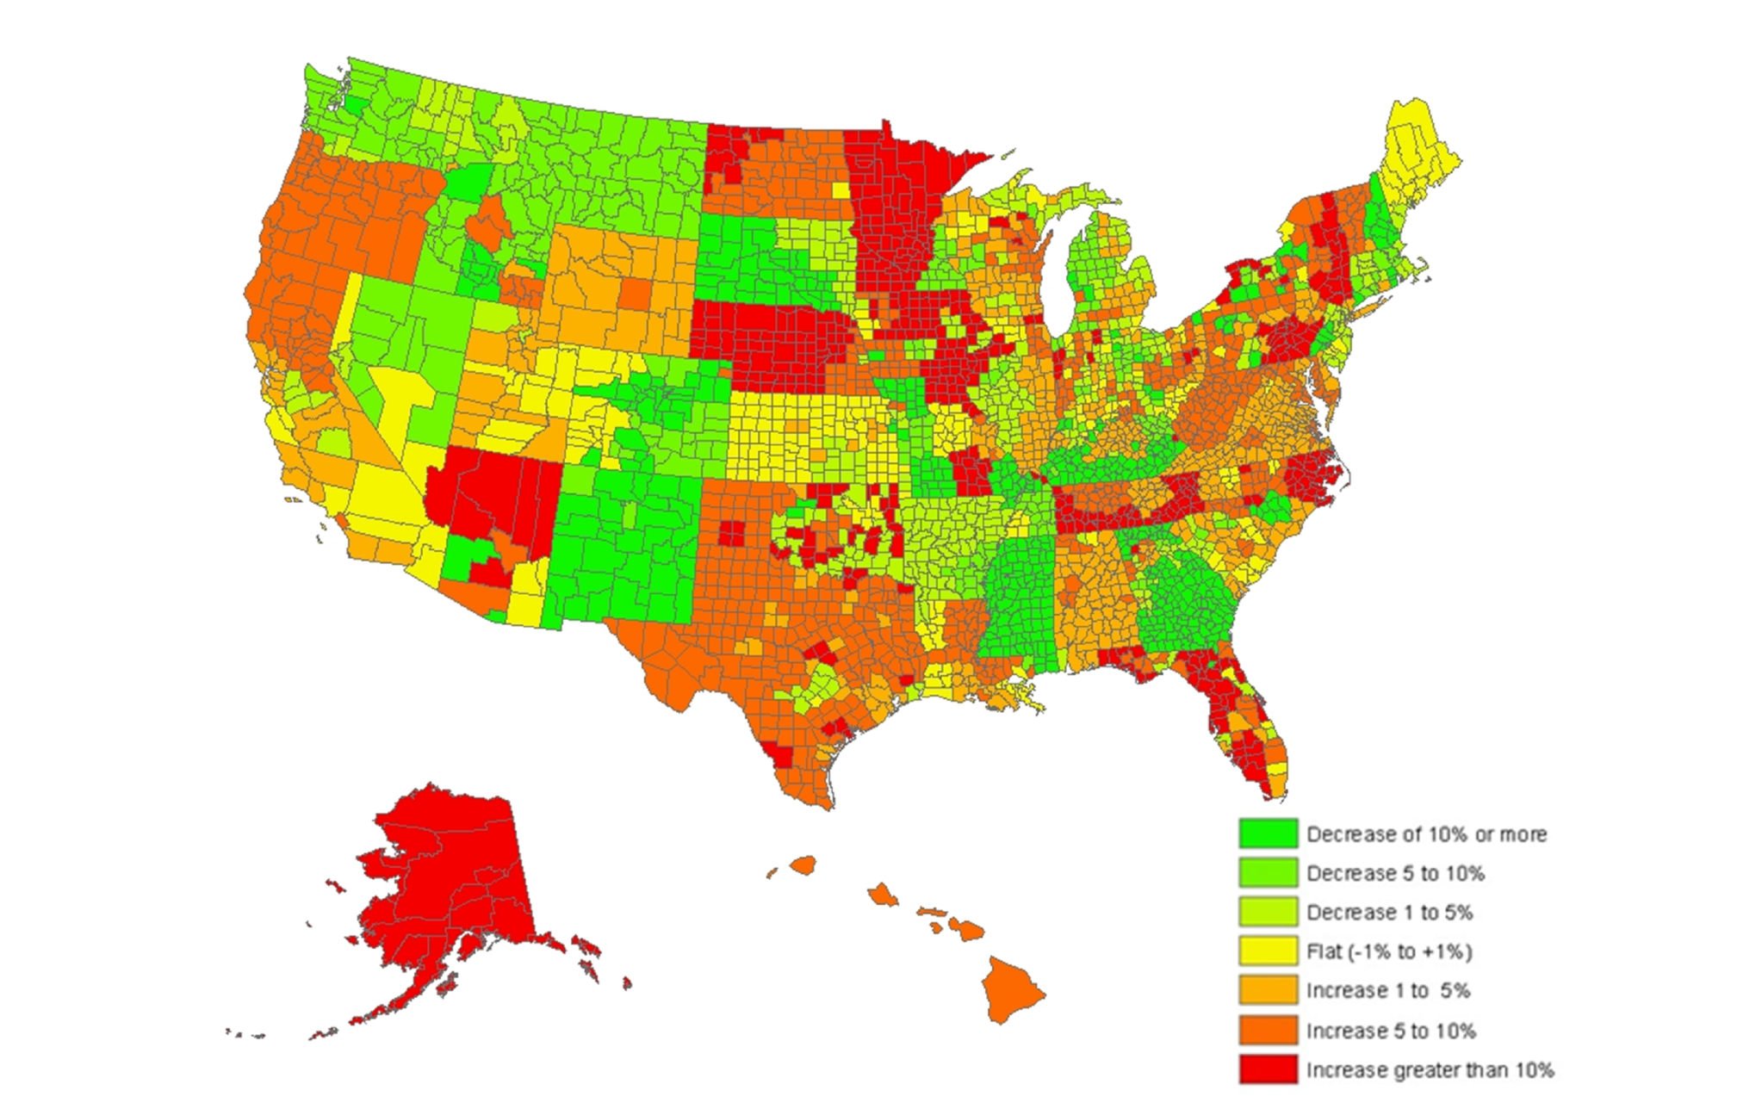
Change in Benchmark Silver Premiums, 2014 – 2015
Percent change in second-lowest silver plan, by county in 50 states and the District of Columbia
Note: In areas in which the two lowest-cost silver plans have the same premium, the next lowest-cost silver plan is used as the “benchmark” silver plan. Source: Kaiser Family Foundation analysis of premium data from Healthcare.gov and insurer rate filings to state regulators. For more information see “Analysis of 2015 Premium Changes in the Affordable Care Act’s Health Insurance Marketplaces” Sep 2014

